Slide 1
In God We Trust
Neurosurgery Morning Report
Department Of Neurosurgery, ABZUMS, Iran
Professor: Dr.Torabi
Presented : Dr.Malekzadeh
https://drmalekmd.ir/uploads/1763110736_3891_VID_20251114_122711_847.mp4
https://drmalekmd.ir/uploads/1763110736_8281_VID_20251114_122711_503.mp4
http://217.218.200.146:8083/study/study-viewer/1.3.12.2.1107.5.1.7.177041.30000025102307053828100000030?isPatientLoginHISLink=true
2160255

Slide 2
Chief Complaint
69 Years Old Female
Sudden onset of weakness in my right arm and leg this morning..

Slide 3
History of Present Illness
Patient is a 69-year-old, right-handed female with a past medical history of hypertension, who presented to the emergency department with the acute onset of right-sided hemiparesis upon waking this morning. She reports significant difficulty with grasping objects with her right hand and ambulating due to leg weakness.Upon further questioning, the patient reports intermittent, dull headaches localized to the left parietal region for the past 3-4 months. The headaches were typically worse in the mornings.Her family also reports observing brief, “jerking” movements in her right hand over the last few weeks, which they had dismissed.She denies any history of generalized seizures, syncope, speech difficulties (aphasia), visual changes, fever, chills, or recent head trauma

Slide 4
Past Medical & Surgical History
PMH:
HTN - diagnosed 10 years ago.
Hyperlipidemia (HLD)
No history of diabetes, coronary artery disease, or cancer
Past Surgical History:
Cesarean section (approx. 35 years ago)
No other surgeries reported.

Slide 5
Medications & Allergies
Medications:
Losartan 25 mg daily
Atorvastatin 20 mg daily
Allergies:No Known Drug Allergies (NKDA).

Slide 6
Family & Social History
Social History:
Housewife. Denies tobacco, alcohol, or illicit drug use.
Family History:
No family history of brain tumors, neurological disorders, or relevant cancers.

Slide 7
Review of Systems (ROS)
Neurological:
Positive for headache and right-sided weakness.
Negative for syncope, dizziness, dysphagia, or diplopia.
Constitutional:
Negative for fever, chills, or unintentional weight loss.
All other systems reviewed and are negative.

Slide 8
Vitals on Admission & GA
BP: 145/85 mmHg
HR: 78 bpm
RR: 16/min
Temp: 37.1°C
SpO2: 97% on RA
Alert and oriented x3, in no acute distress. / Lying Still In Bed

Slide 9
Physical Examination
HEENT: Normocephalic, atraumatic
Mental Status: GCS 15/15 (E4V5M6).
Alert, oriented, follows commands.
Cranial Nerves: II-XII are grossly intact.
Pupils are 3mm, equal, round, and reactive to light (PERRL).
Visual fields are full to confrontation.
Motor System: Strength: Left Upper/Lower Extremity: 5/5
Right Upper/Lower Extremity: 4/5 | Tone: Normal throughout. |
Reflexes: 2+ and symmetric throughout.

Slide 10
Physical Examination
Plantar Response: Flexor on the left, Equivocal/Neutral on the right.
Involuntary Movements: A subtle action tremor is noted in the right upper extremity.
Sensory System: Decreased sensation to light touch and proprioception on the right side.
Cerebellar: Finger-to-Nose is intact on the left. Right side is difficult to assess due to weakness and tremor.
Gait: Mild right hemiparetic gait with circumduction of the right leg

Slide 11
Imaging
Non-Contrast Head CT:
Revealed a well-circumscribed, hyperdense, and heterogeneous mass in the high left parasagittal parietal lobe.
Significant surrounding vasogenic edema with associated mass effect on the adjacent brain parenchyma.

Slide 12
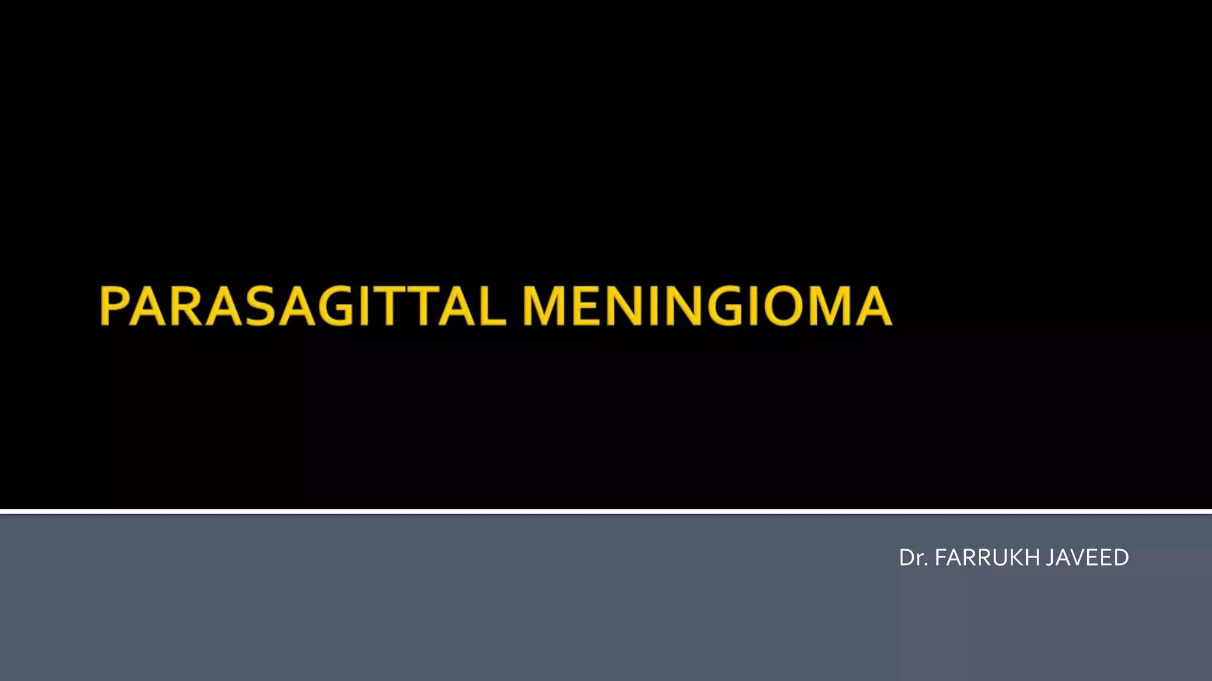

Slide 13
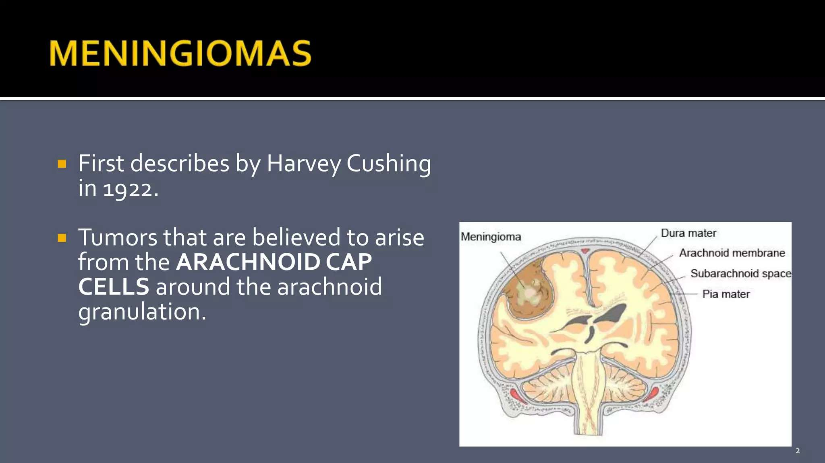

Slide 14
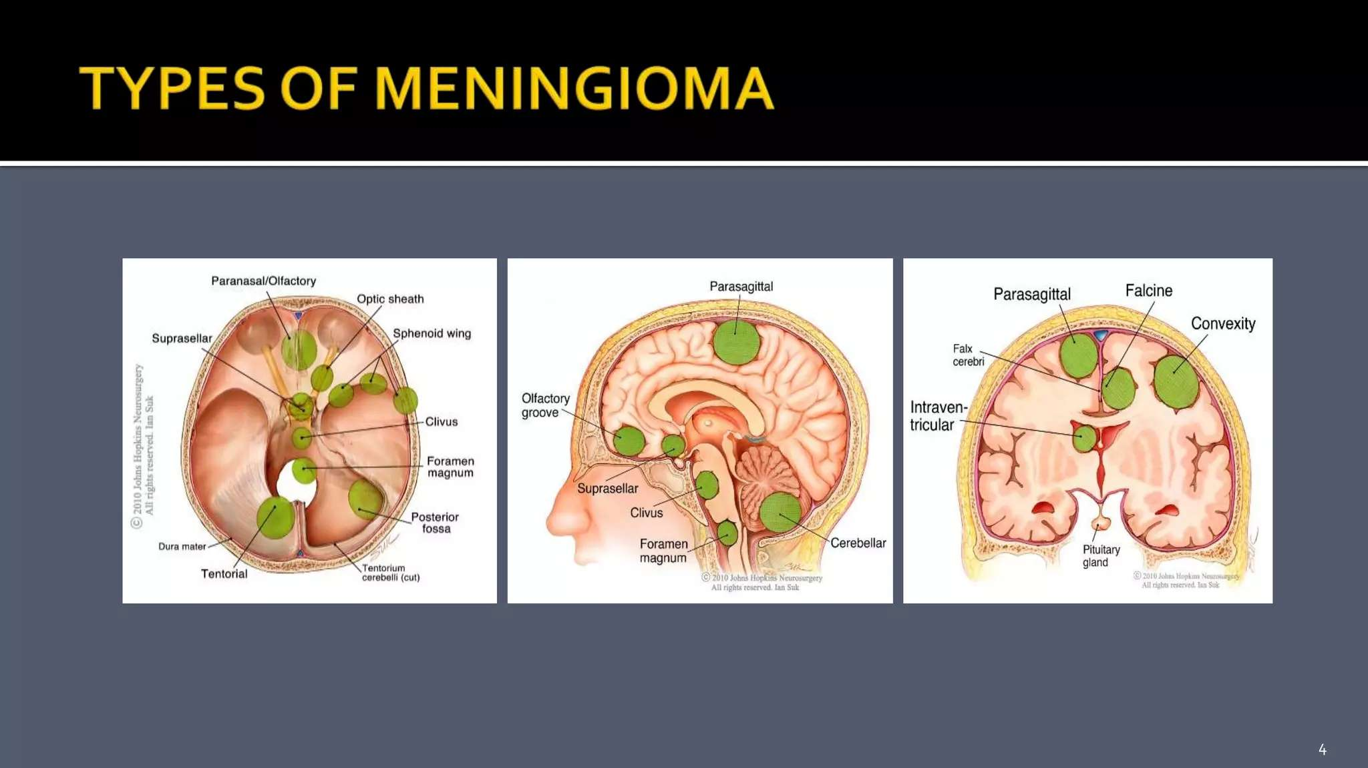

Slide 15
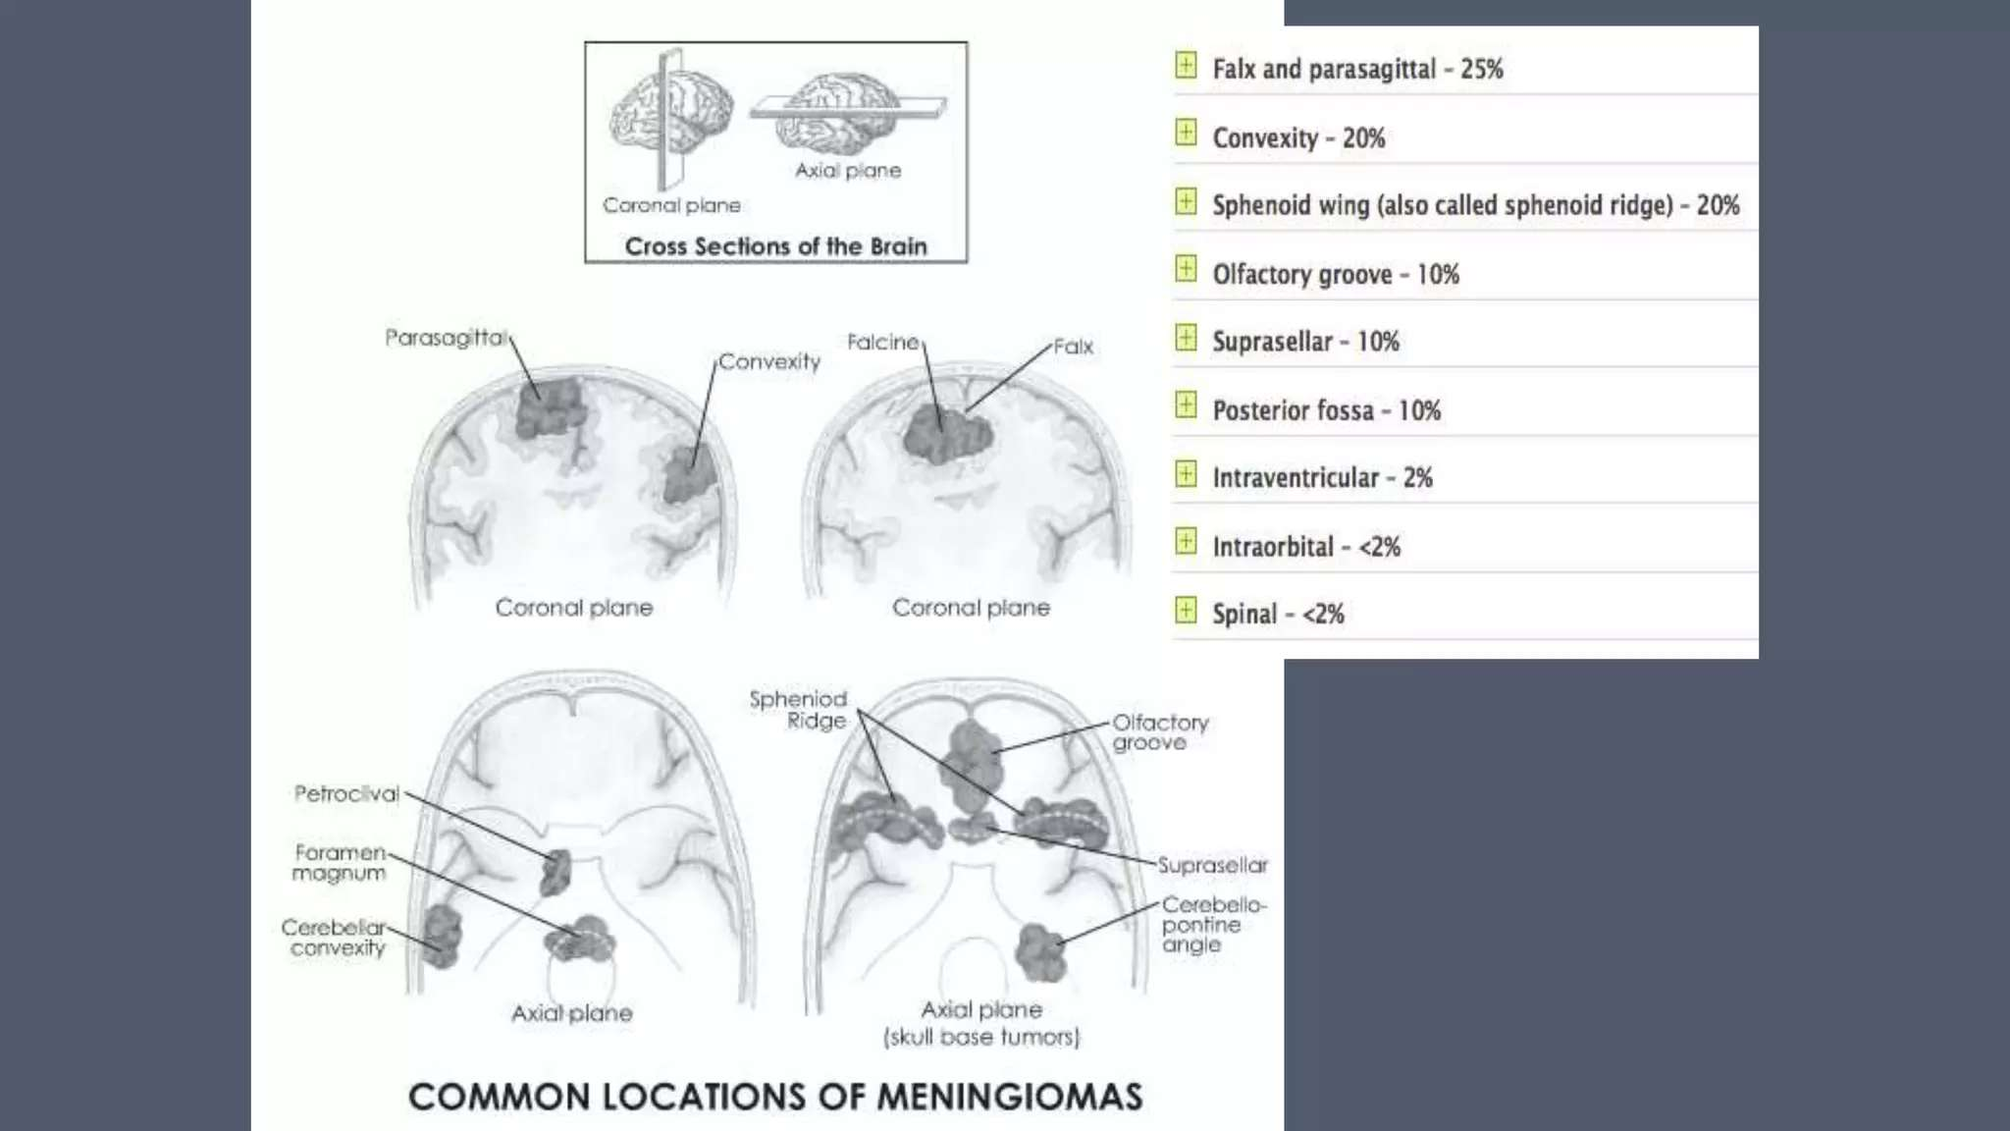

Slide 16
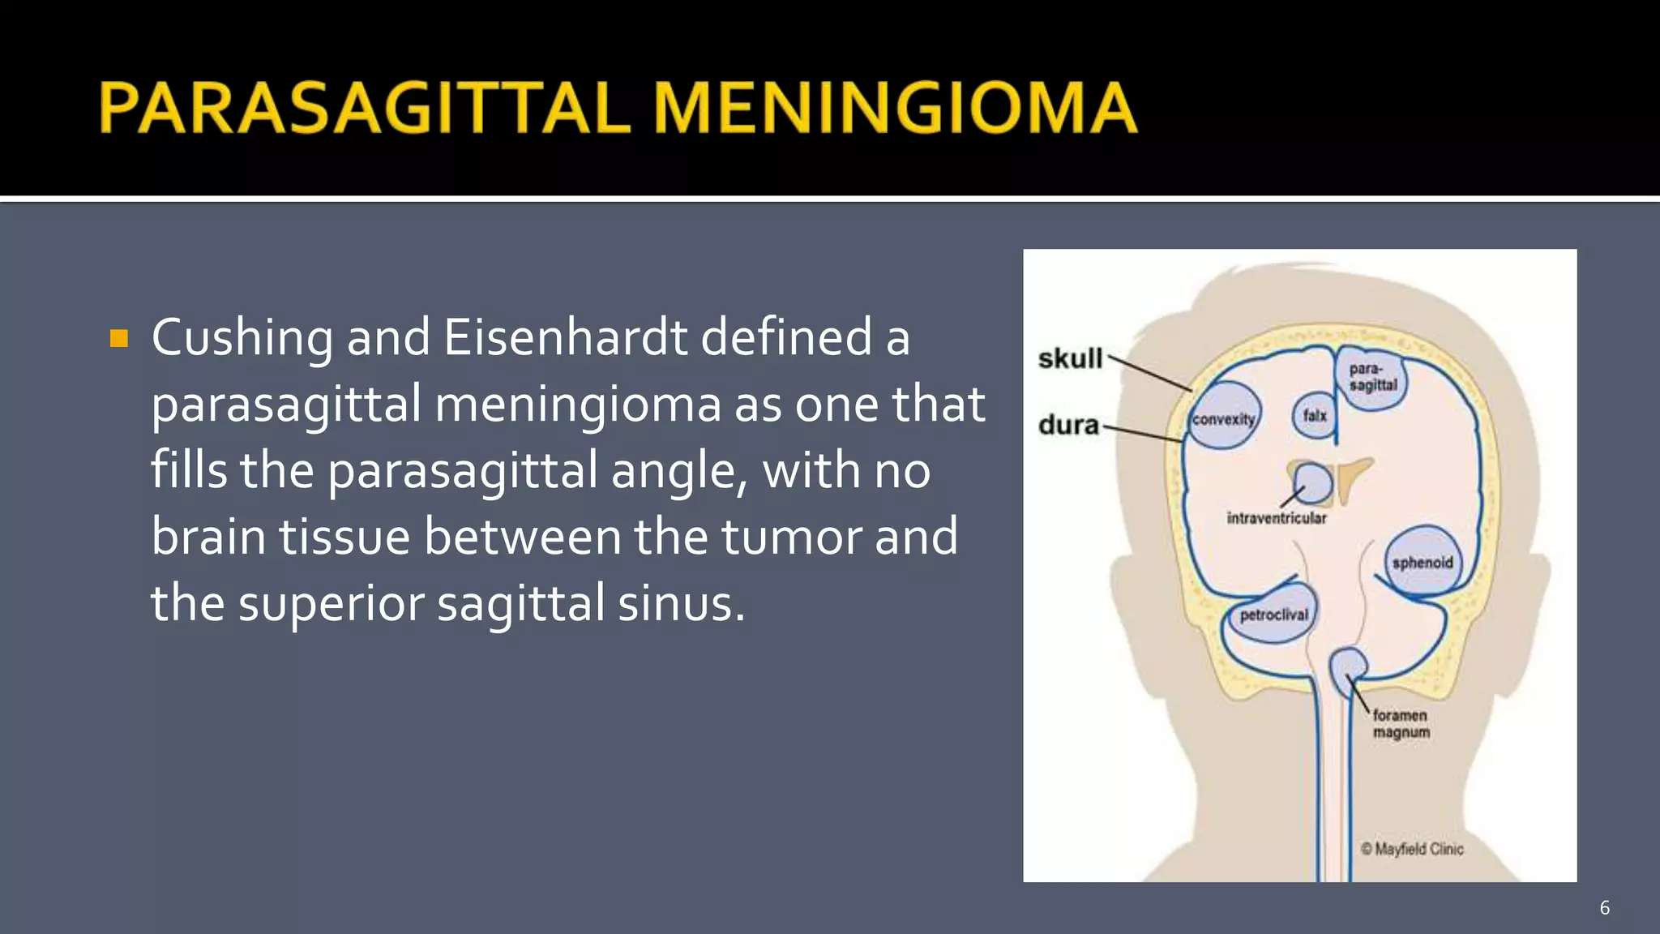

Slide 17
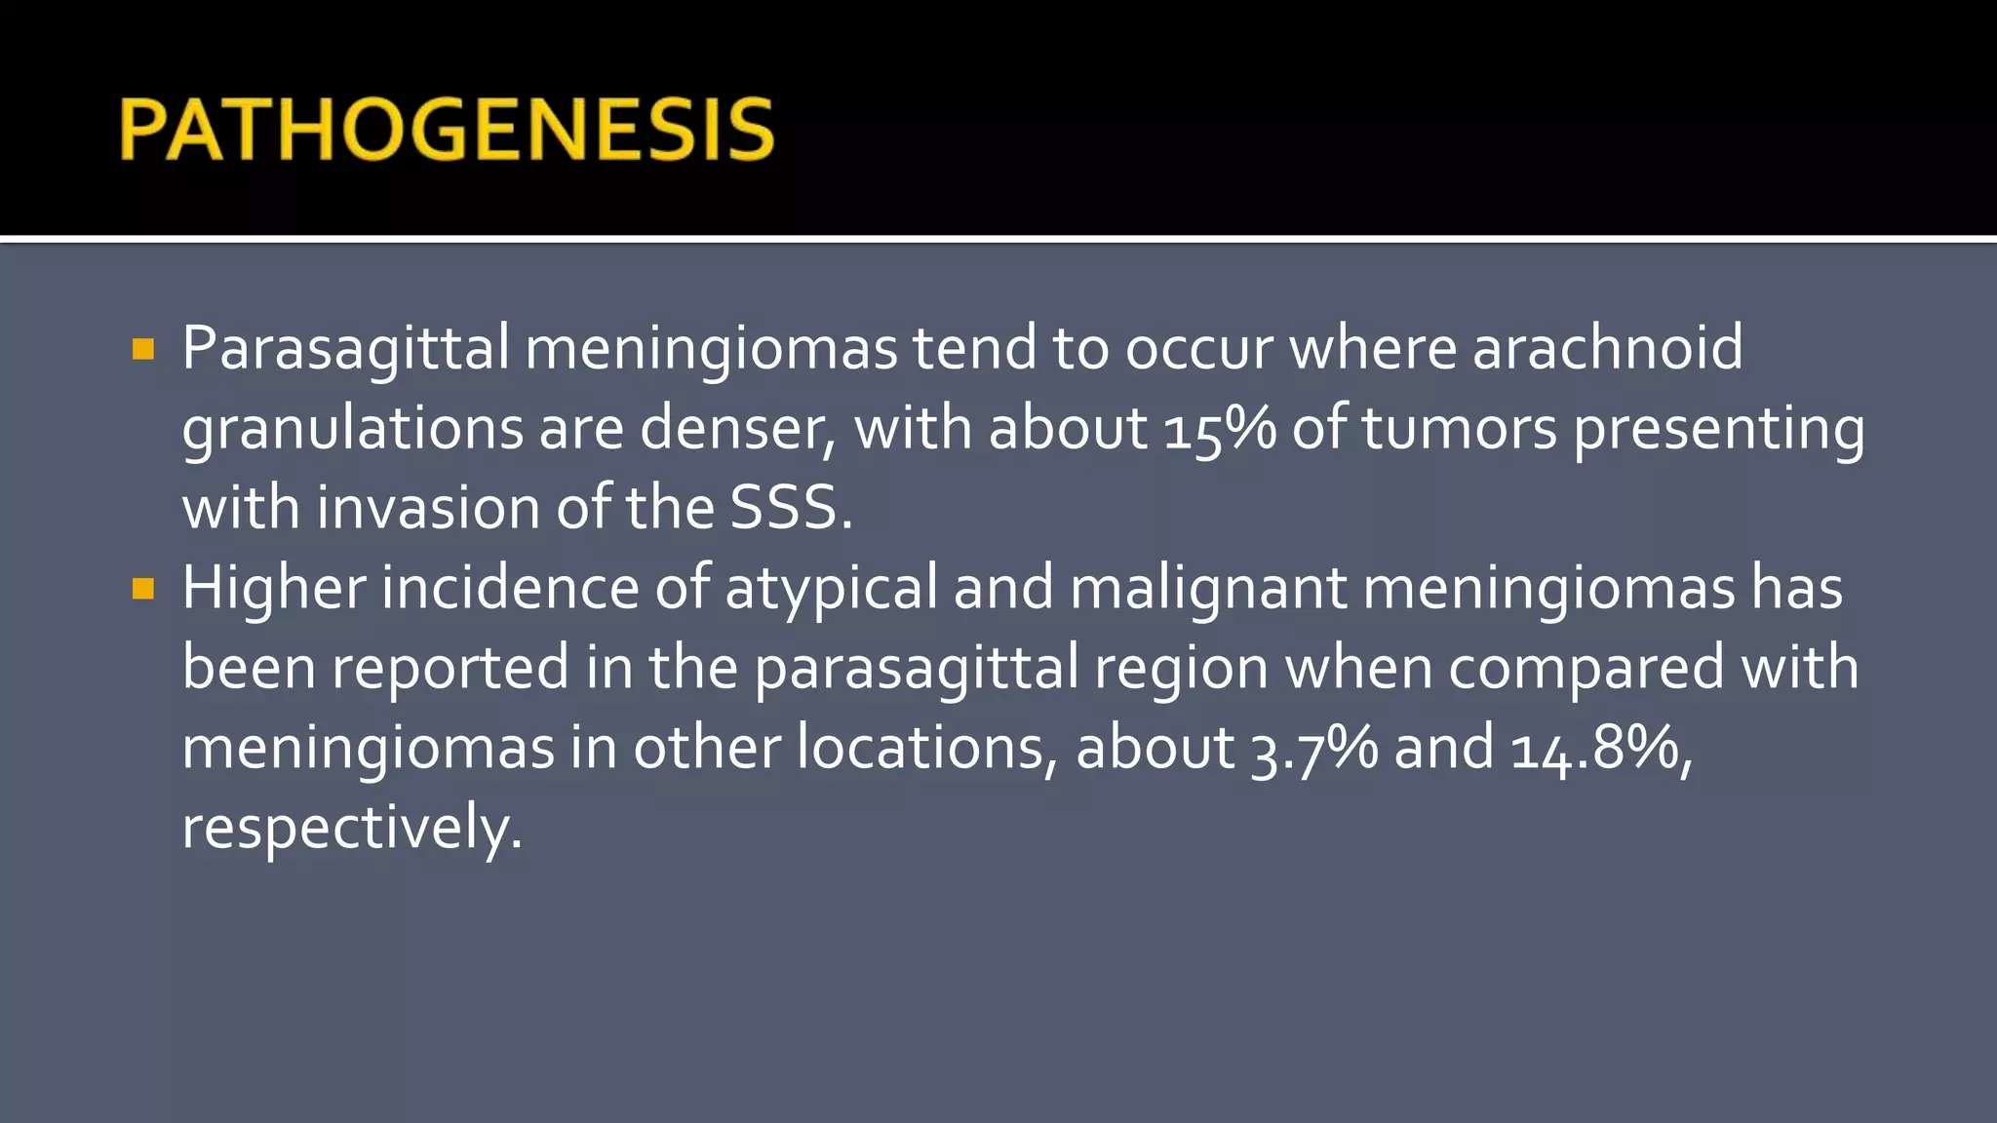

Slide 18
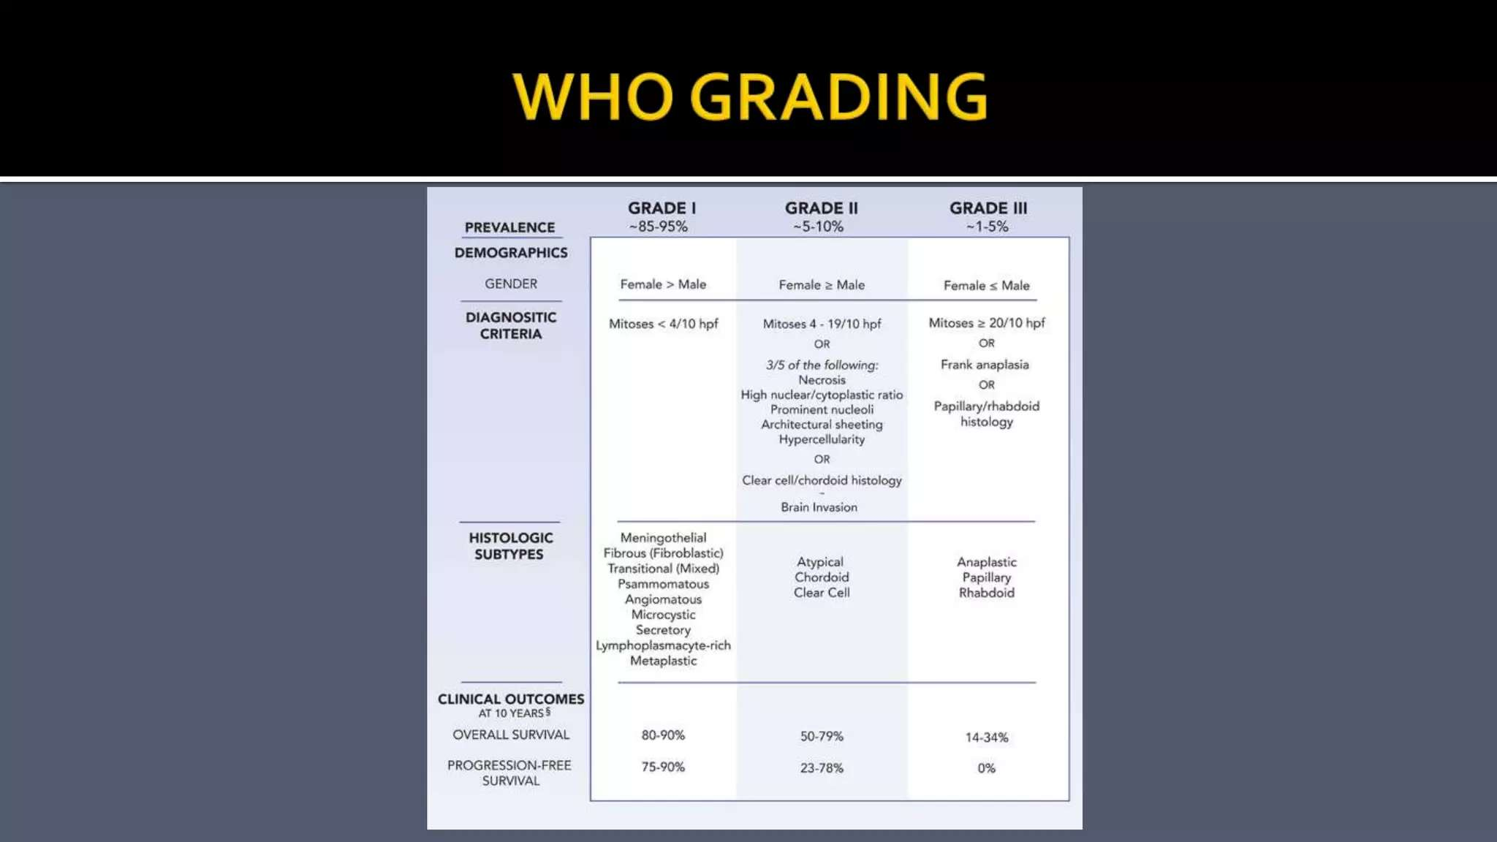

Slide 19
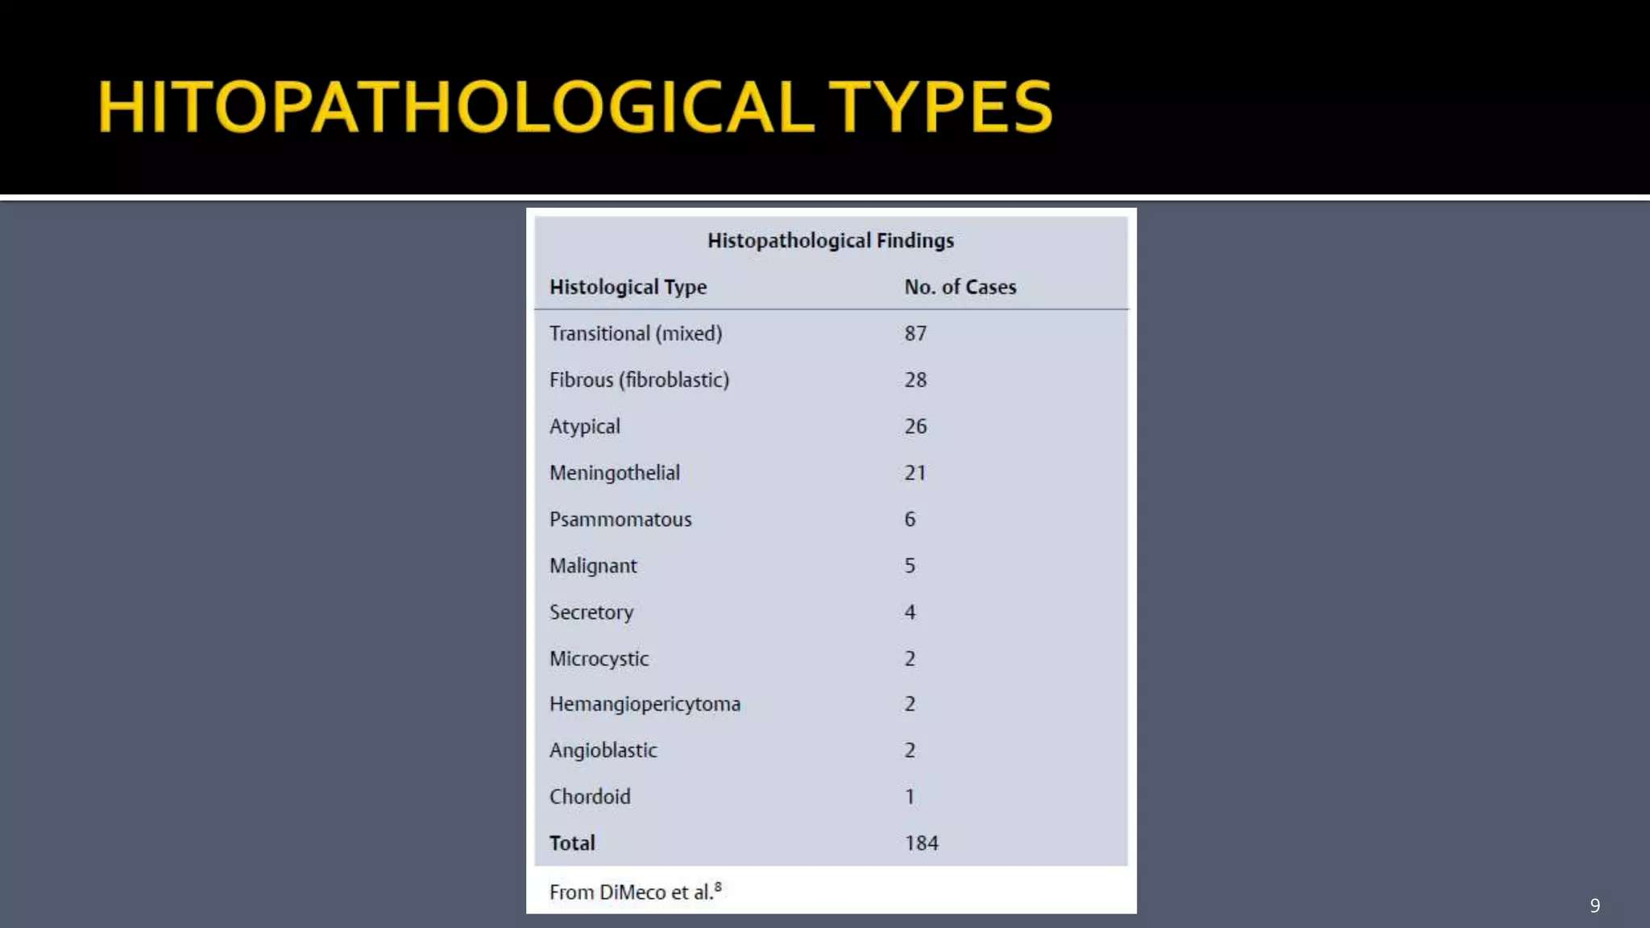

Slide 20
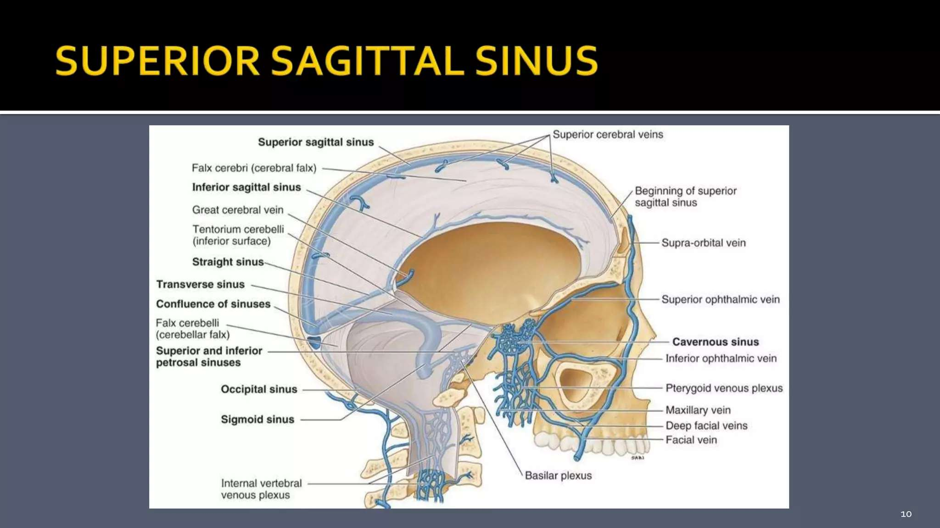

Slide 21
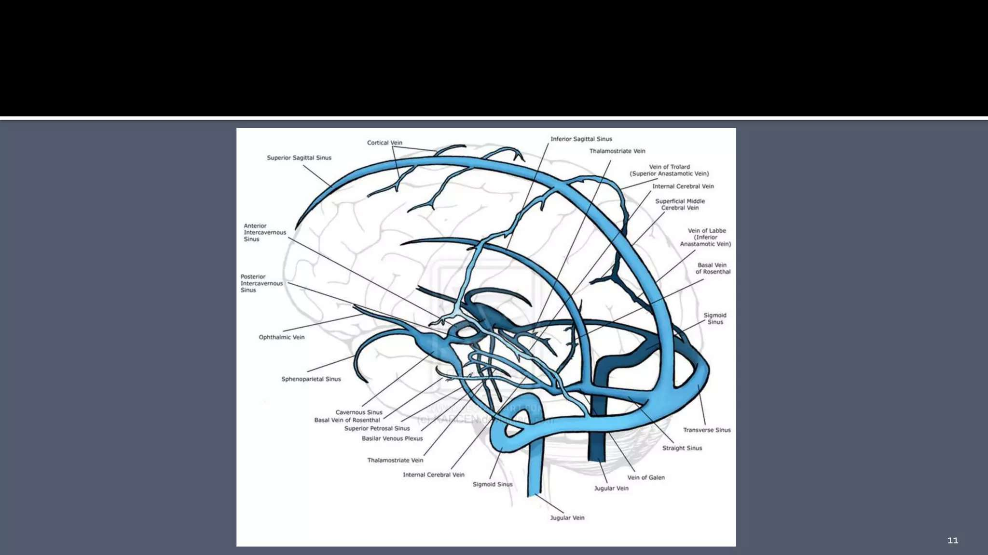

Slide 22
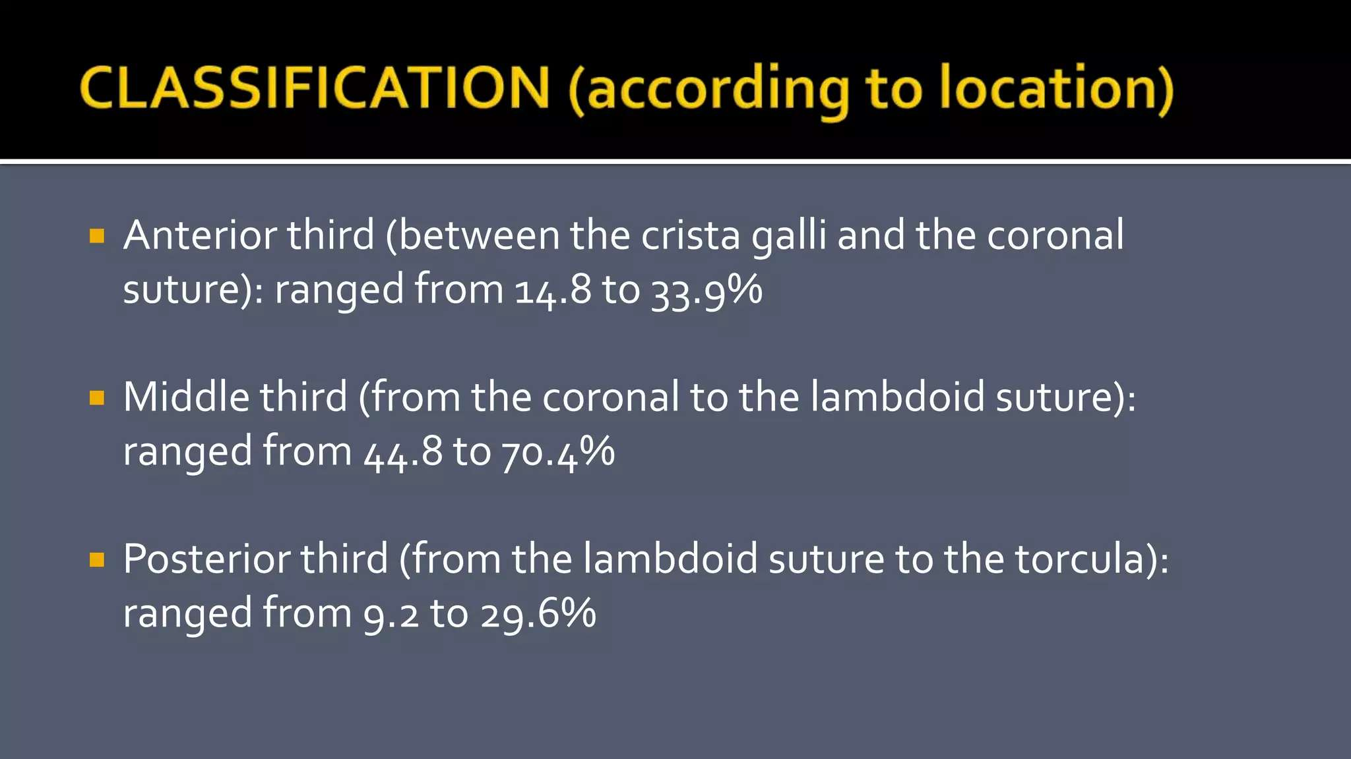

Slide 23
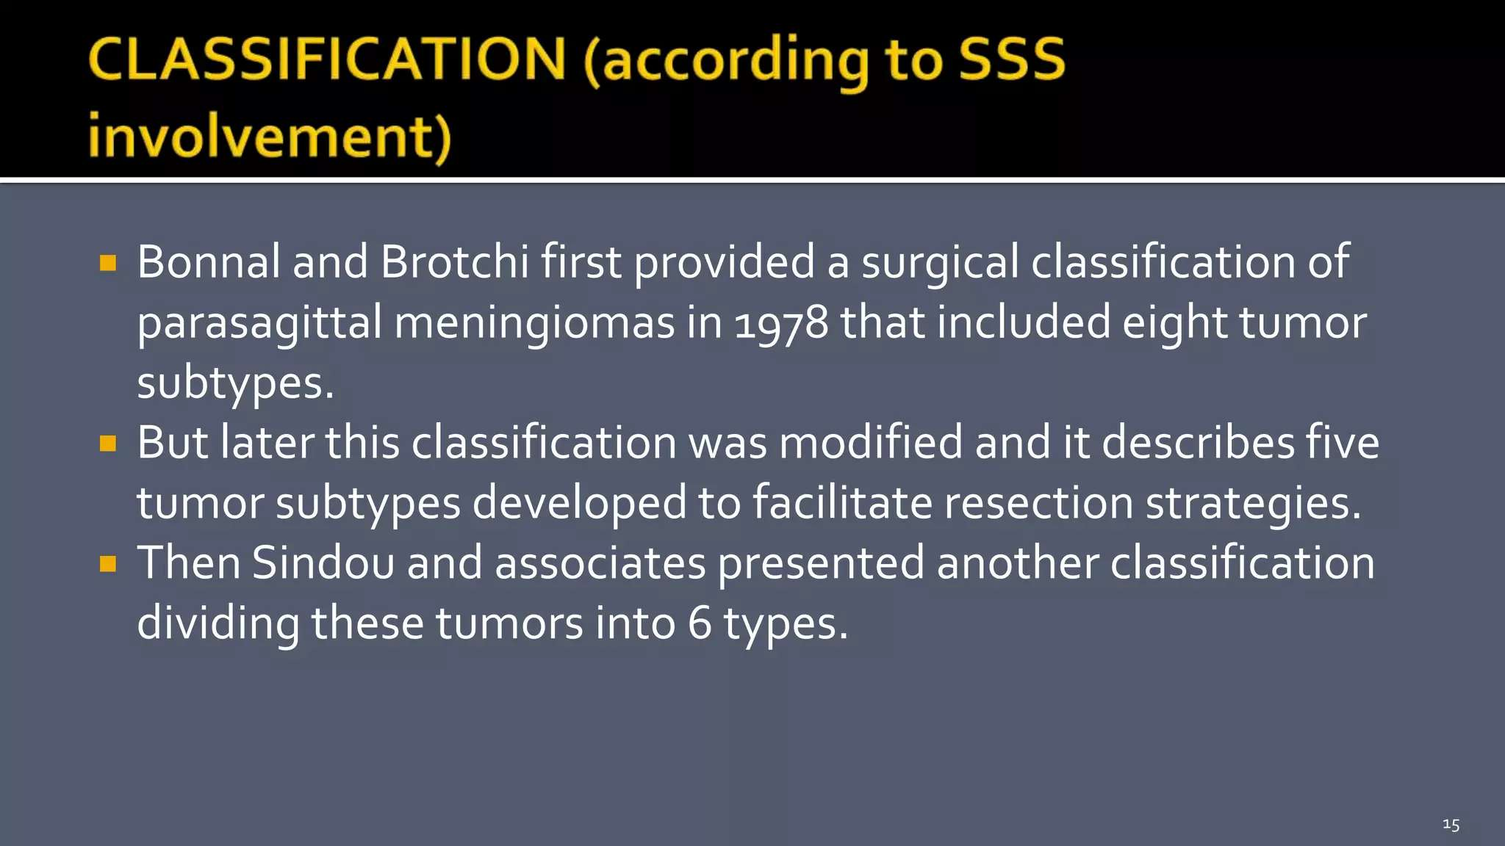

Slide 24
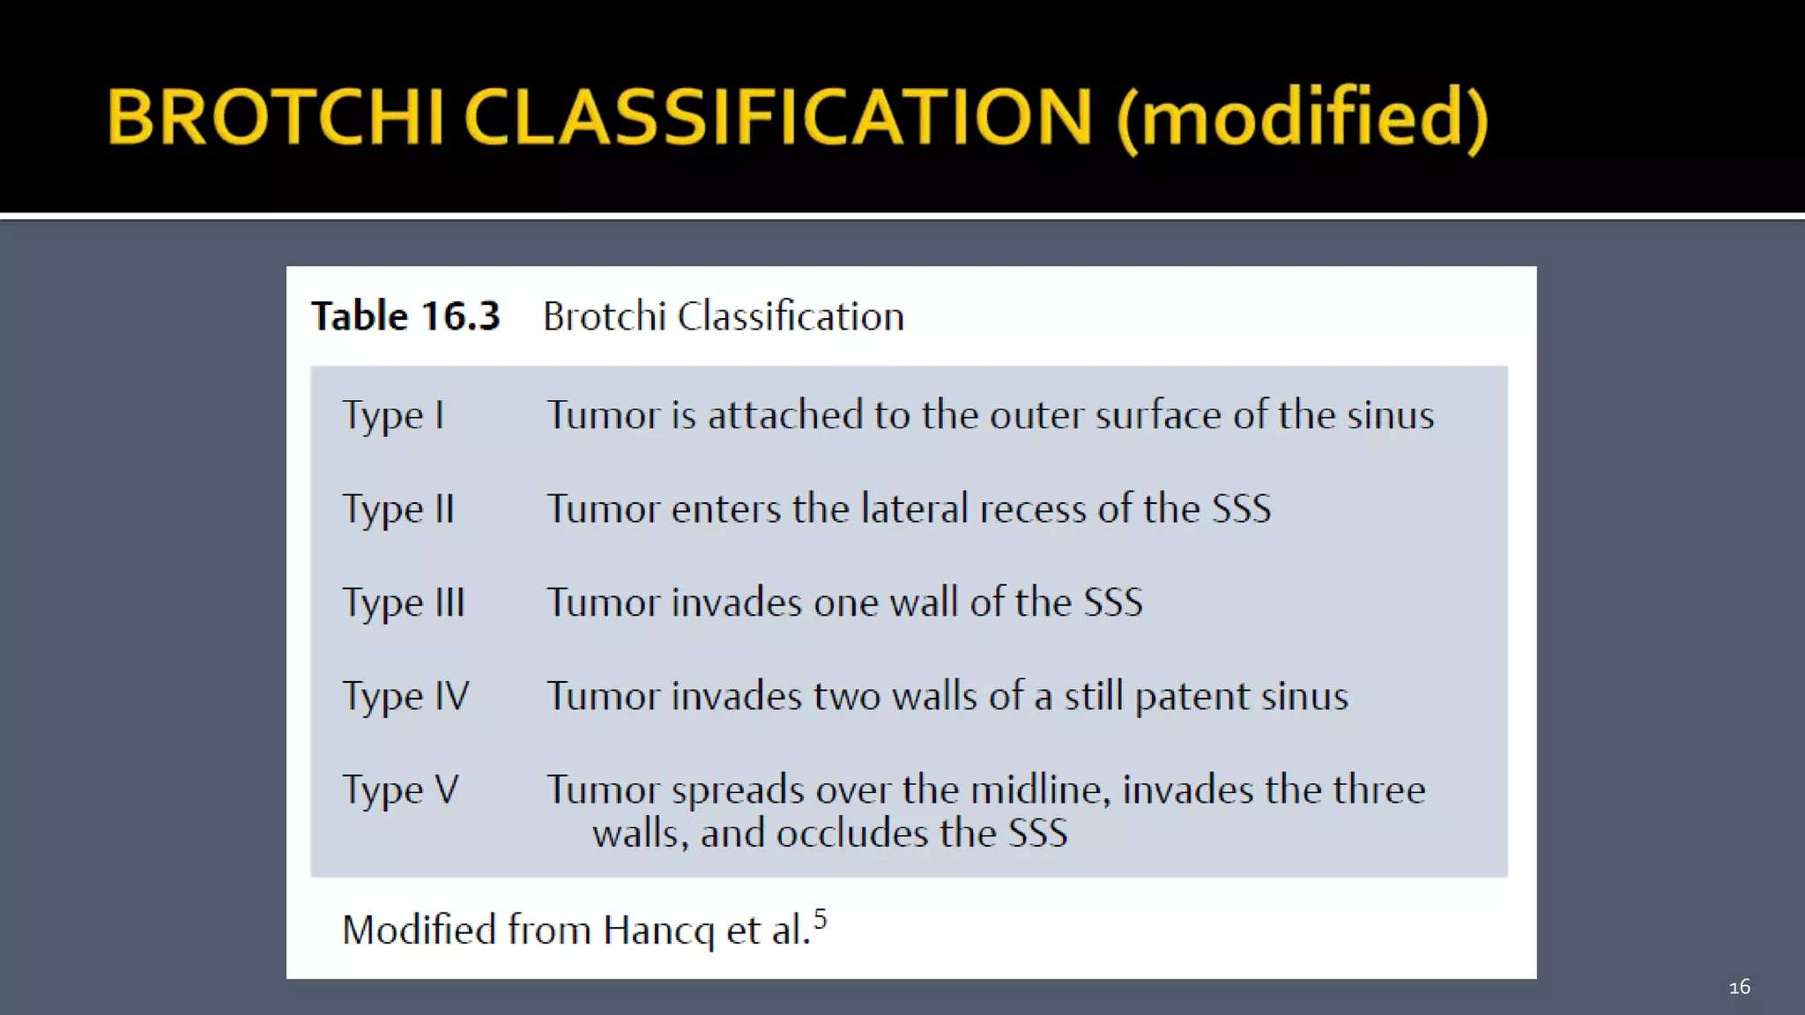

Slide 25
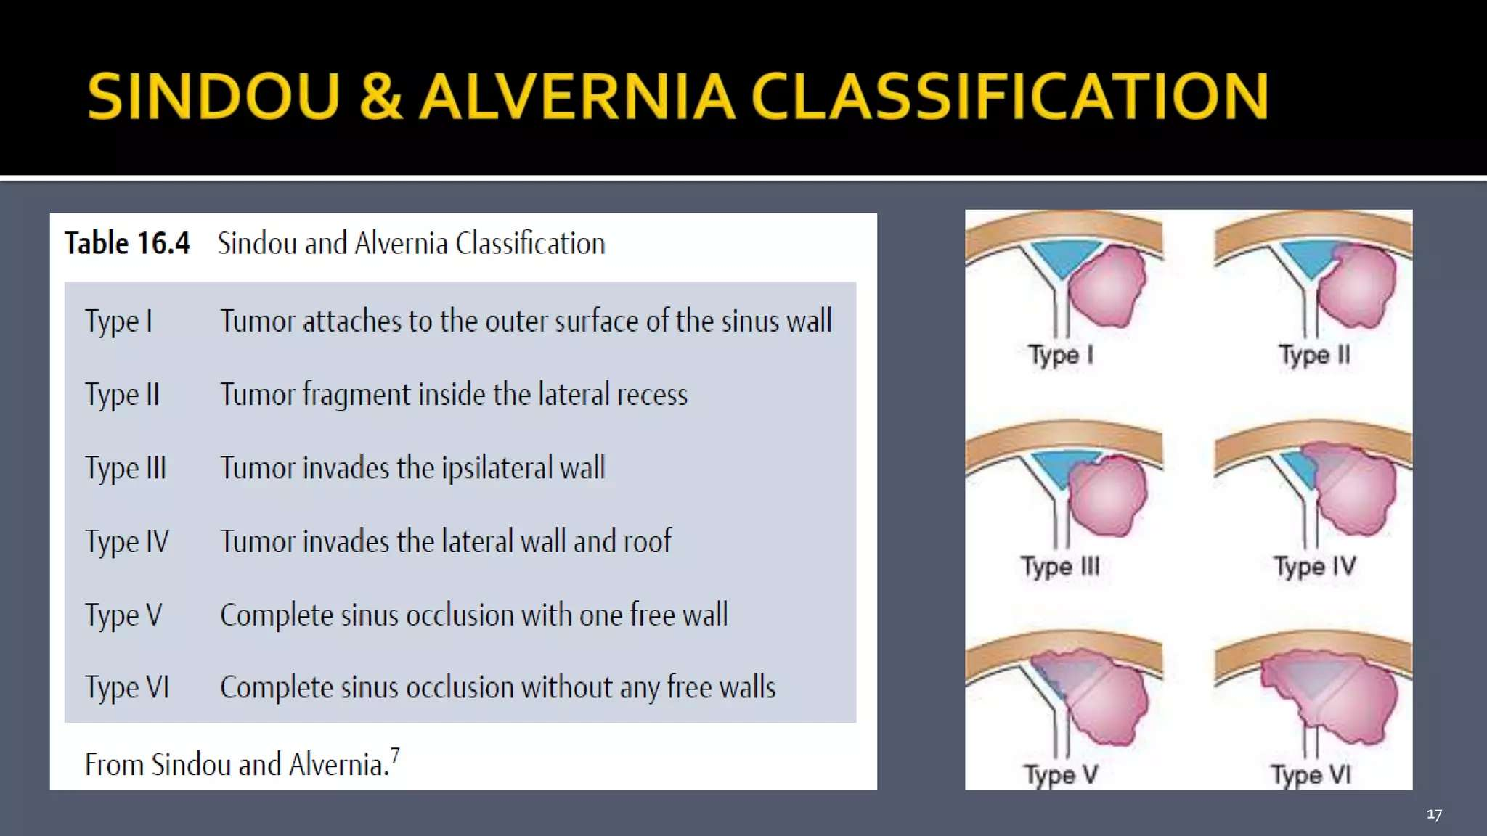

Slide 26
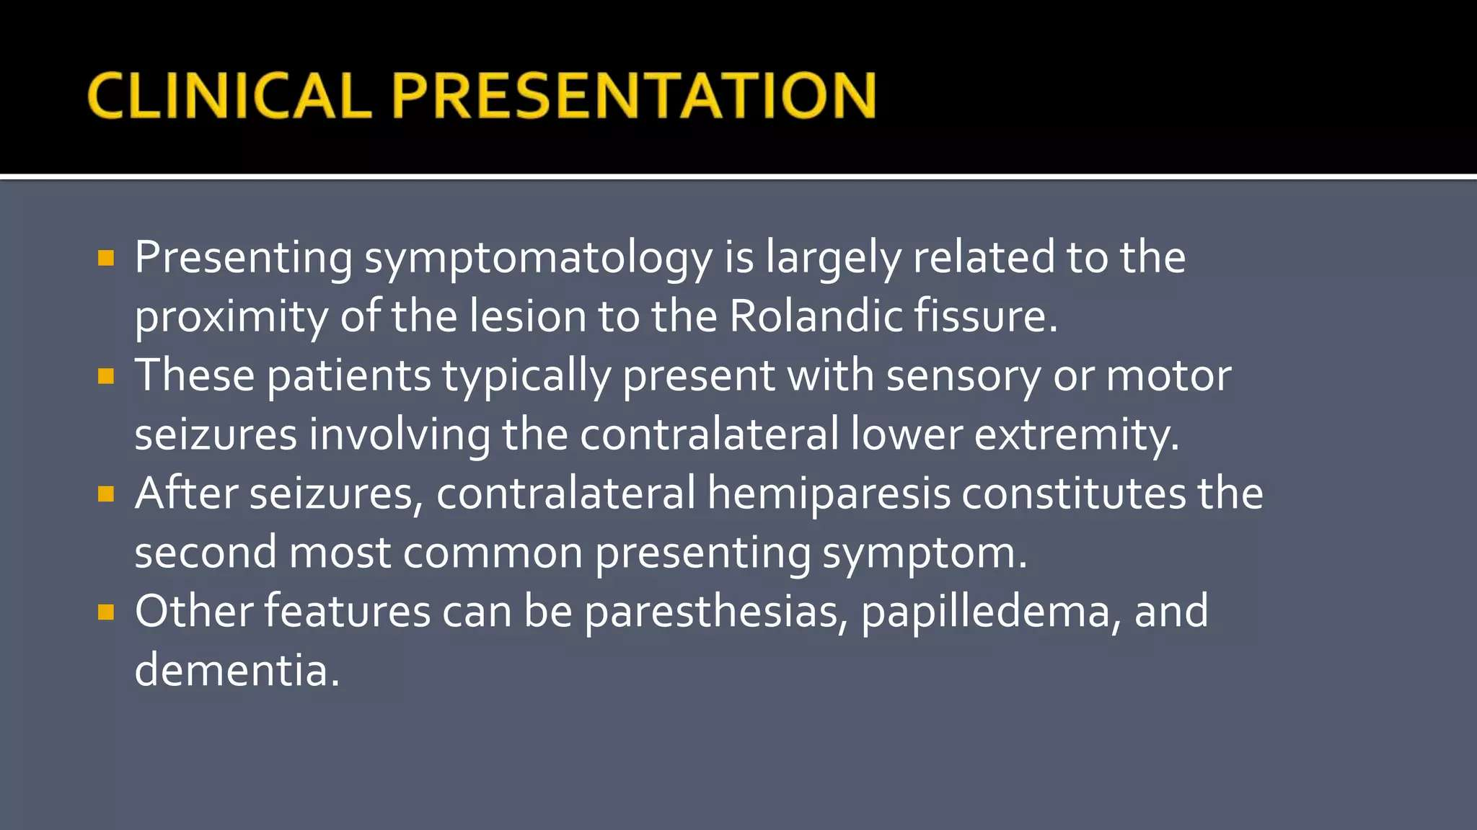

Slide 27
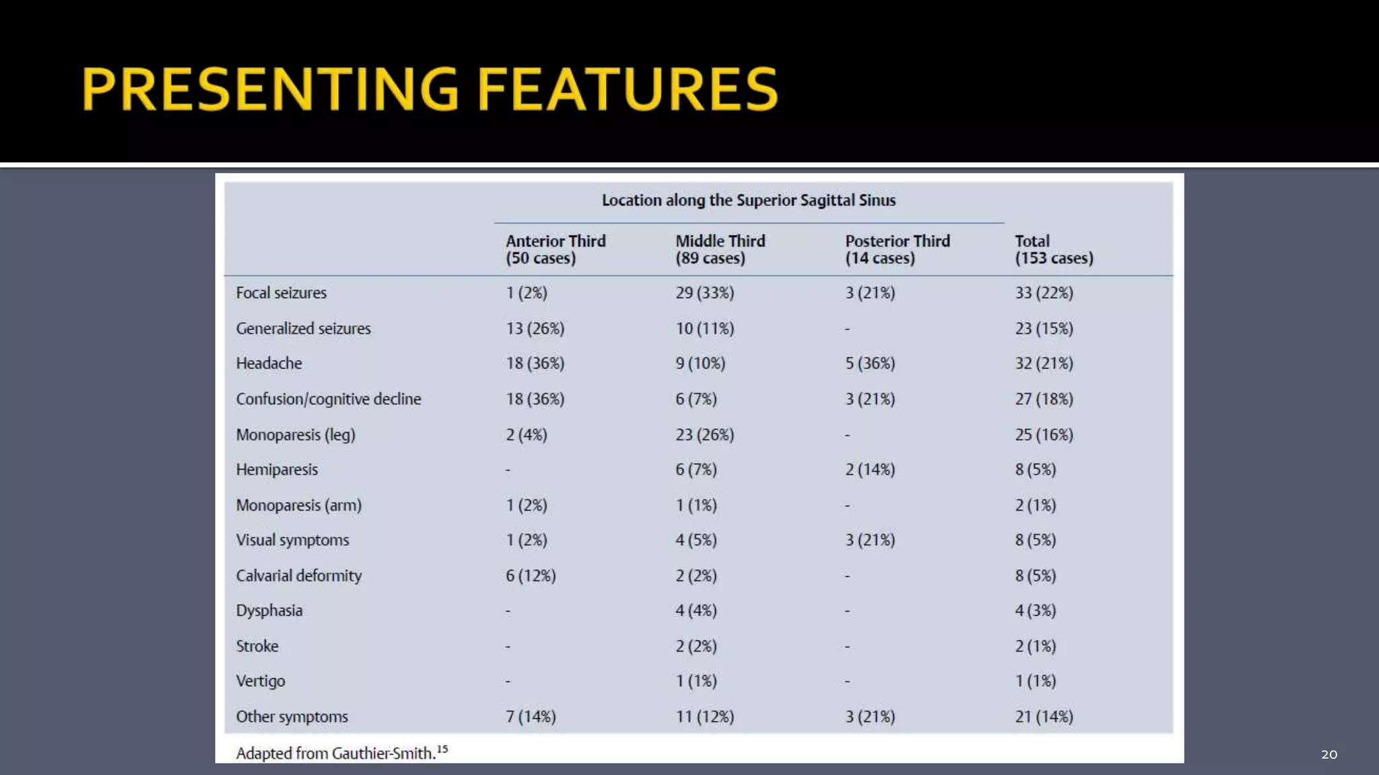

Slide 28
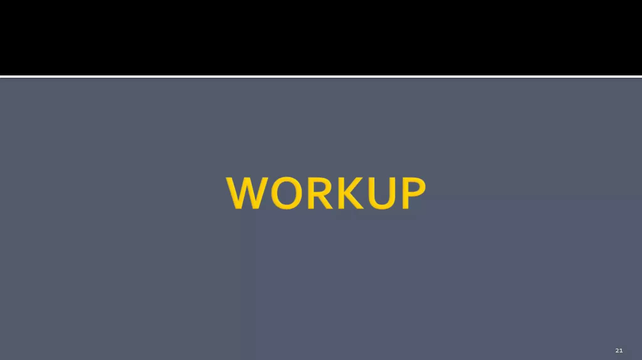

Slide 29
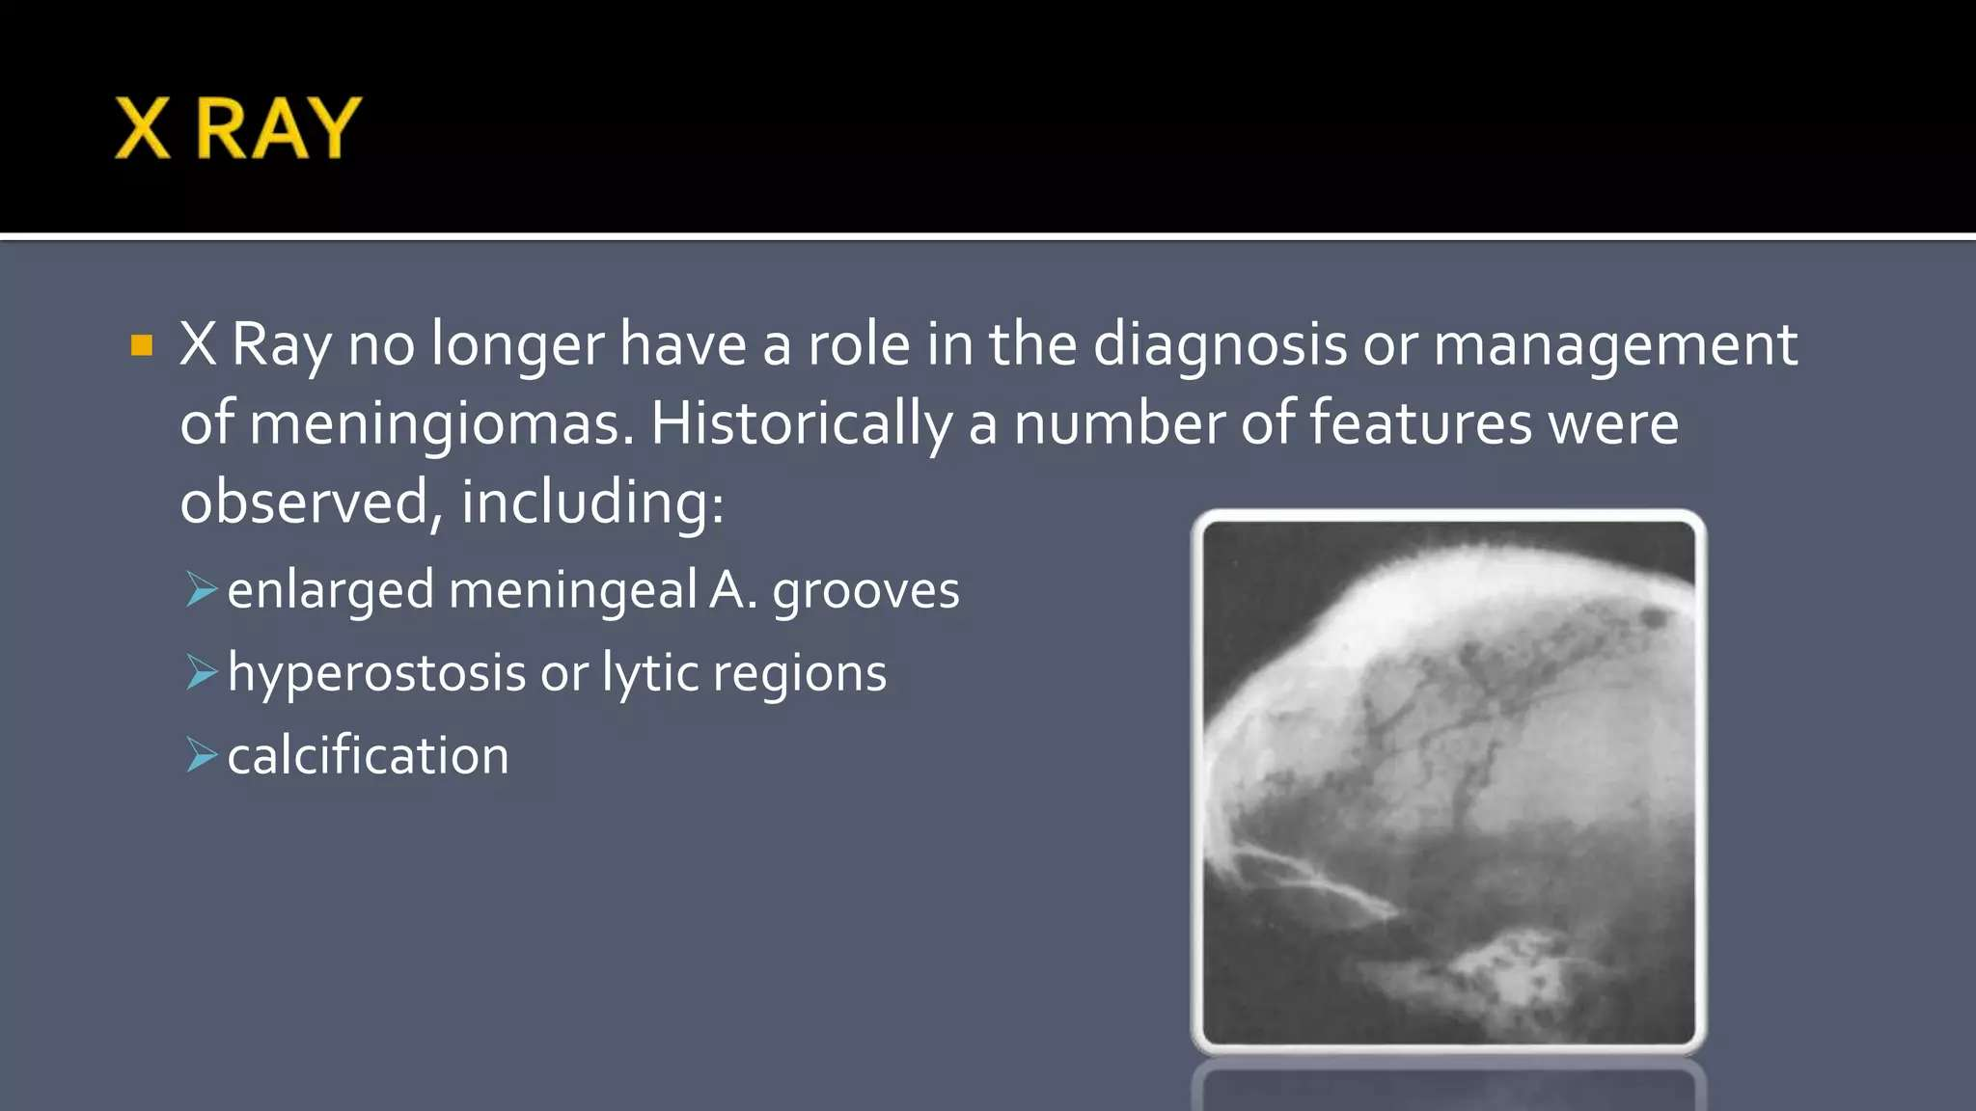

Slide 30
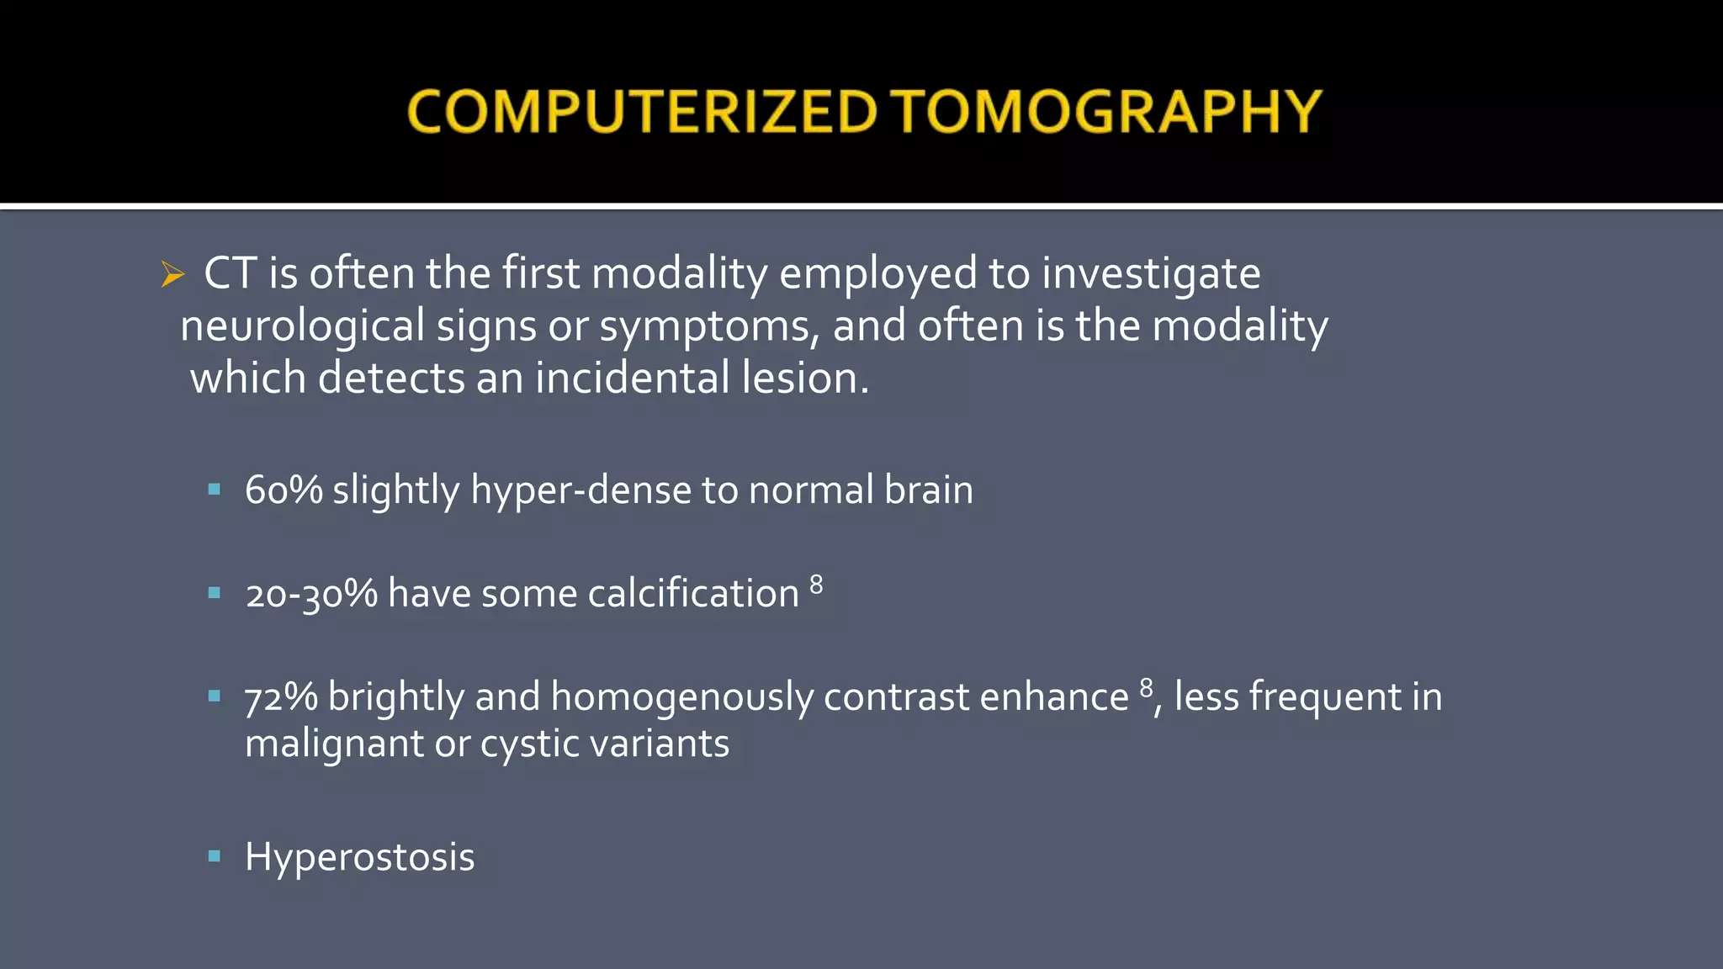

Slide 31
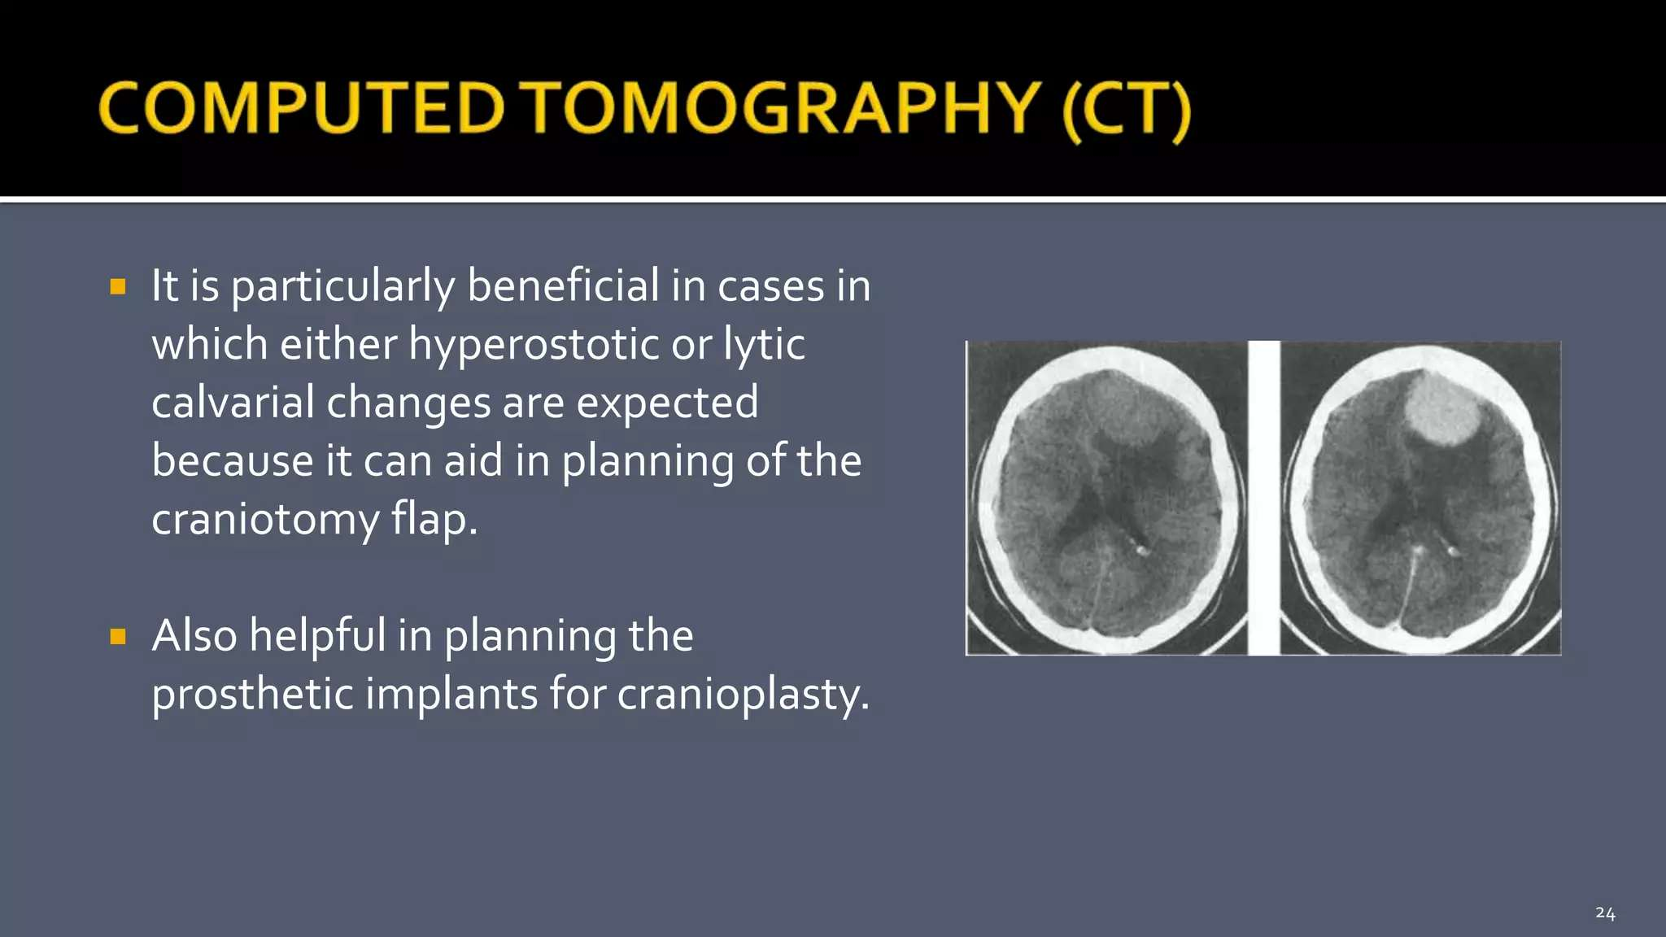

Slide 32
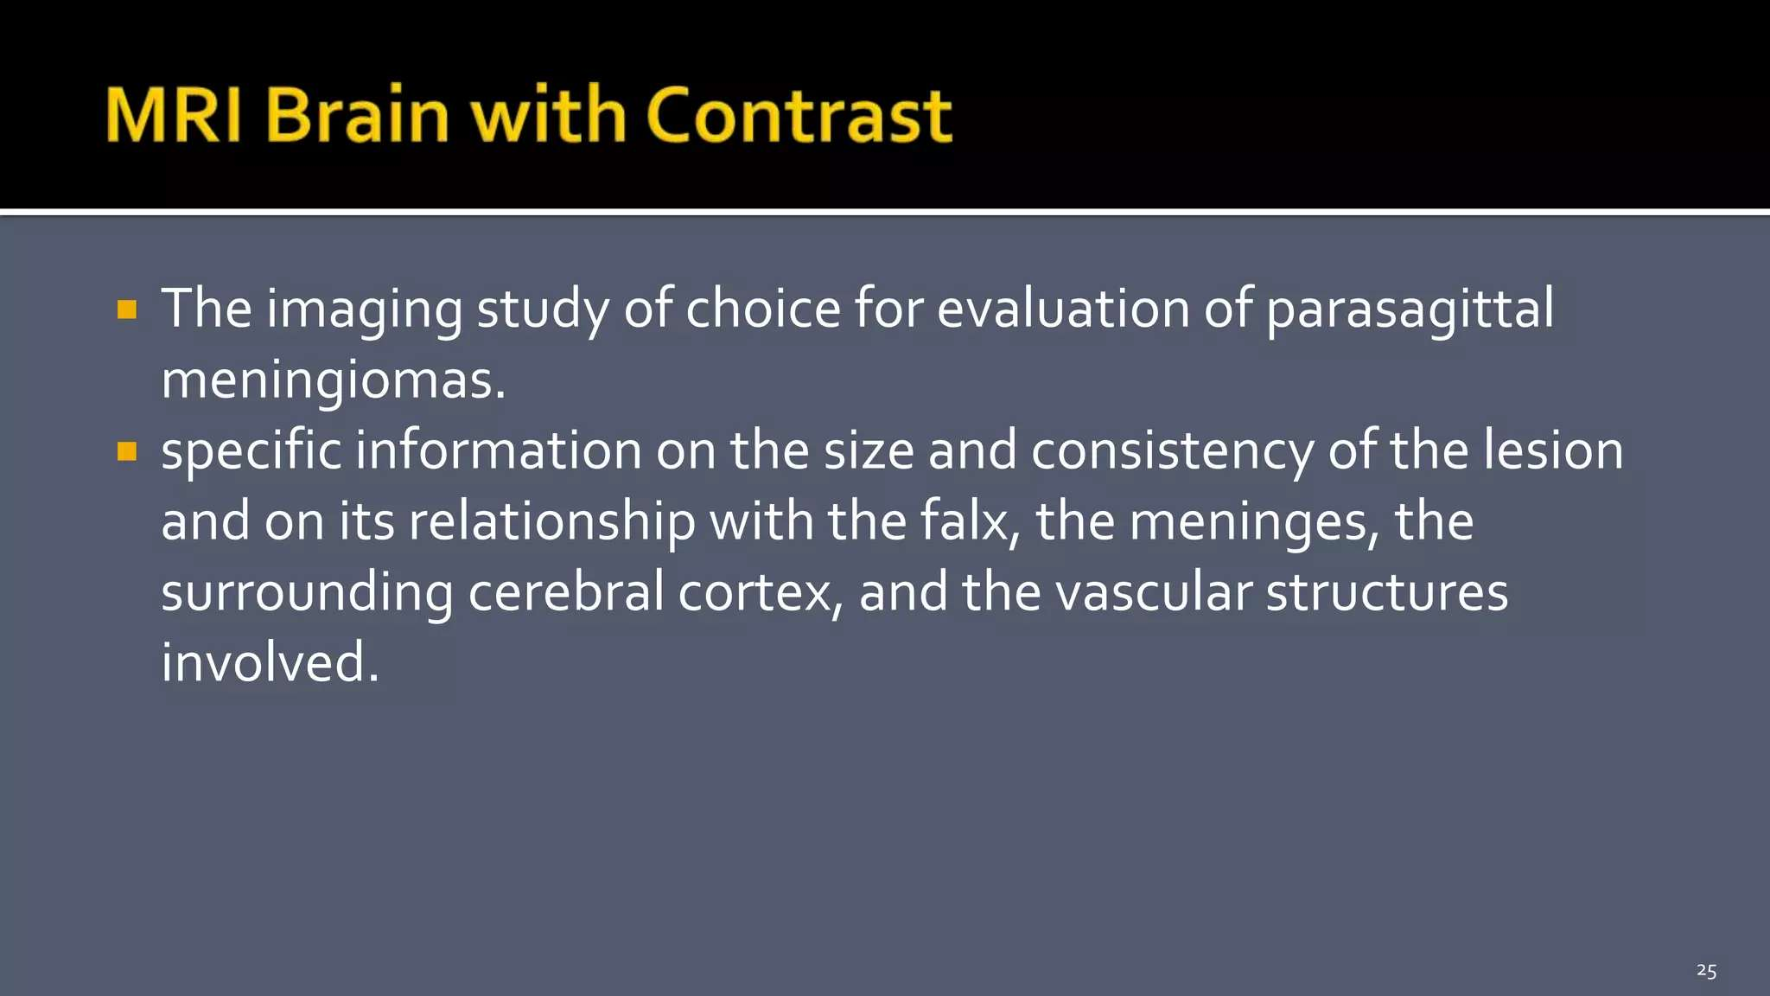

Slide 33
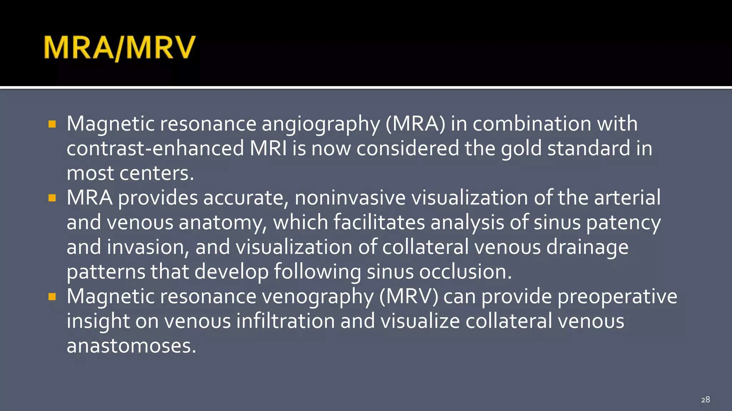

Slide 34
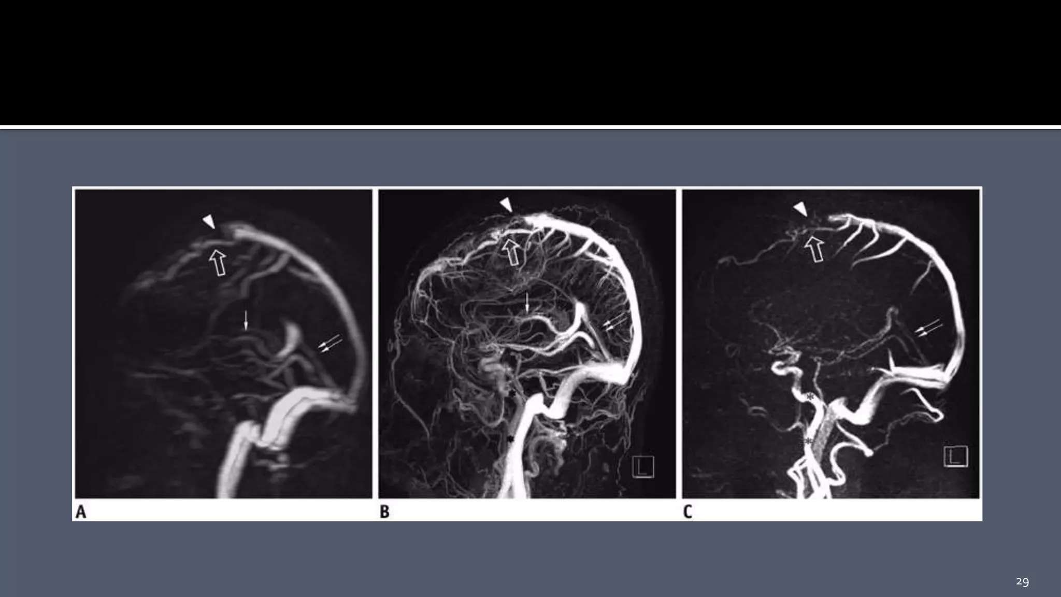

Slide 35
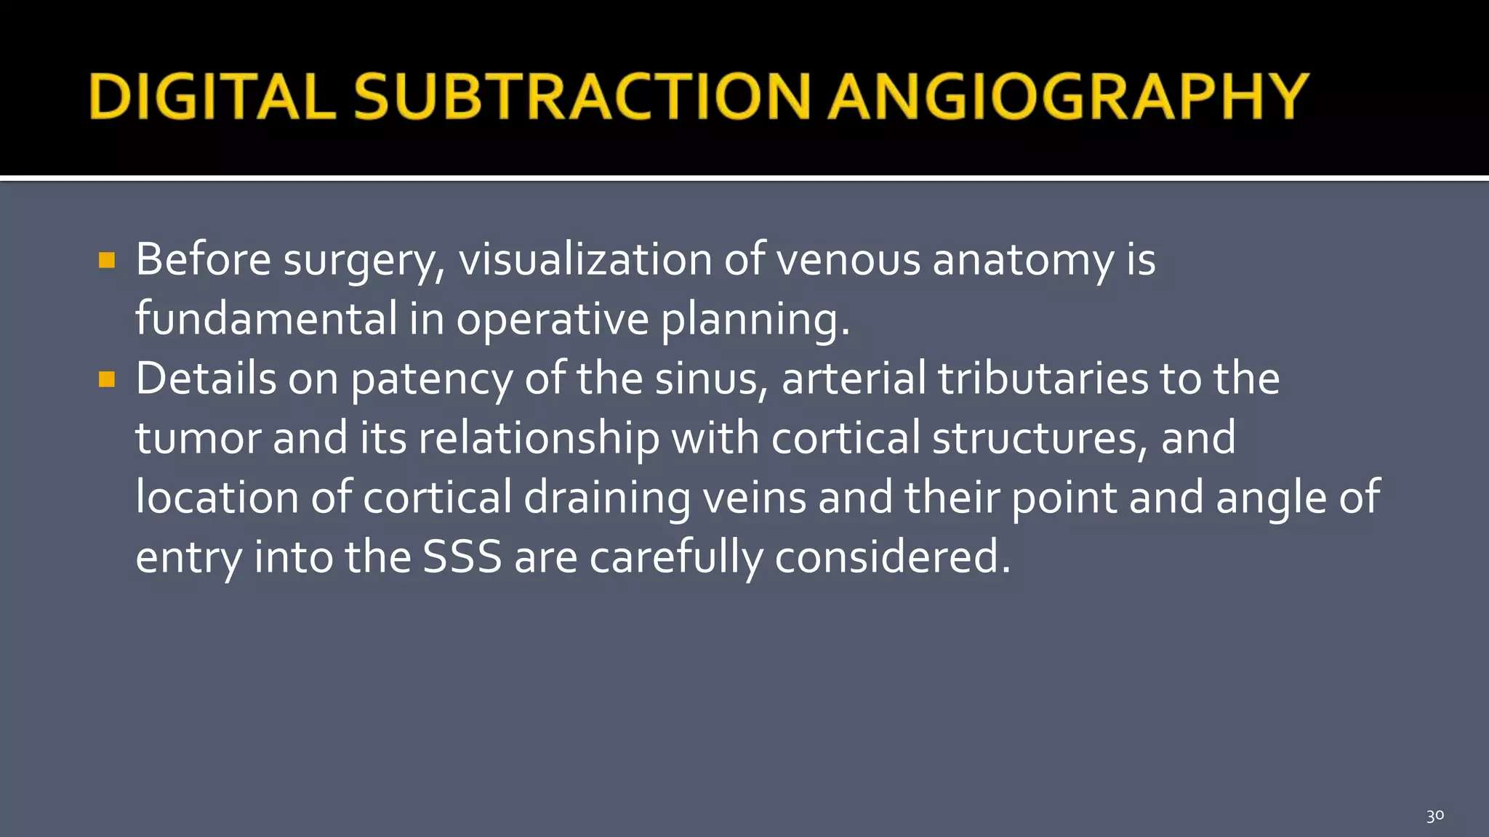

Slide 36
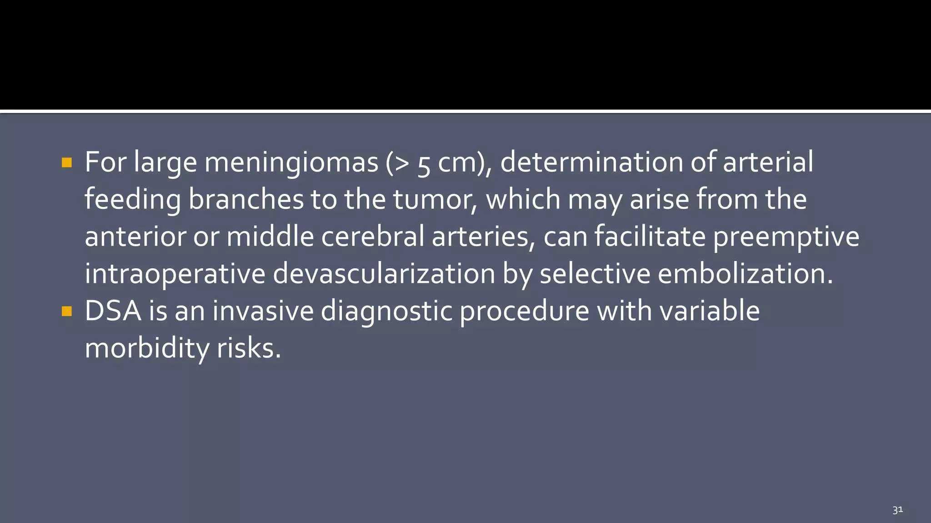

Slide 37
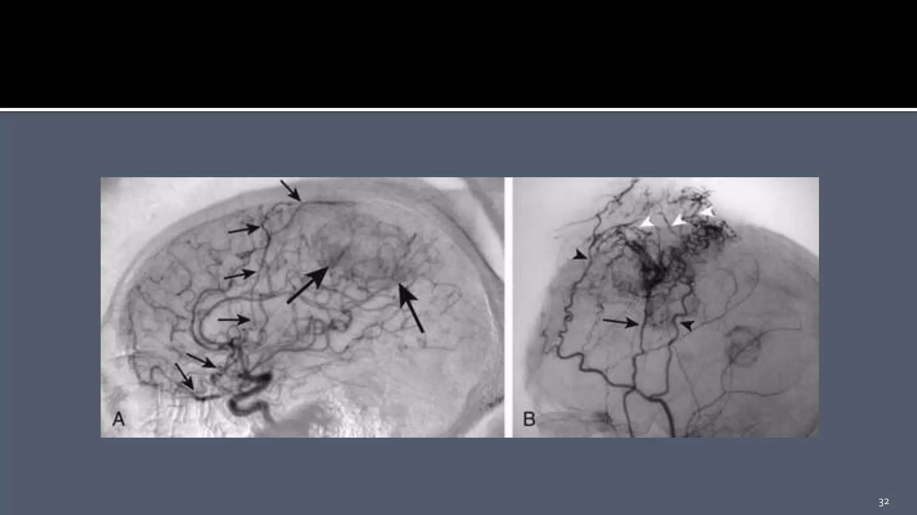

Slide 38
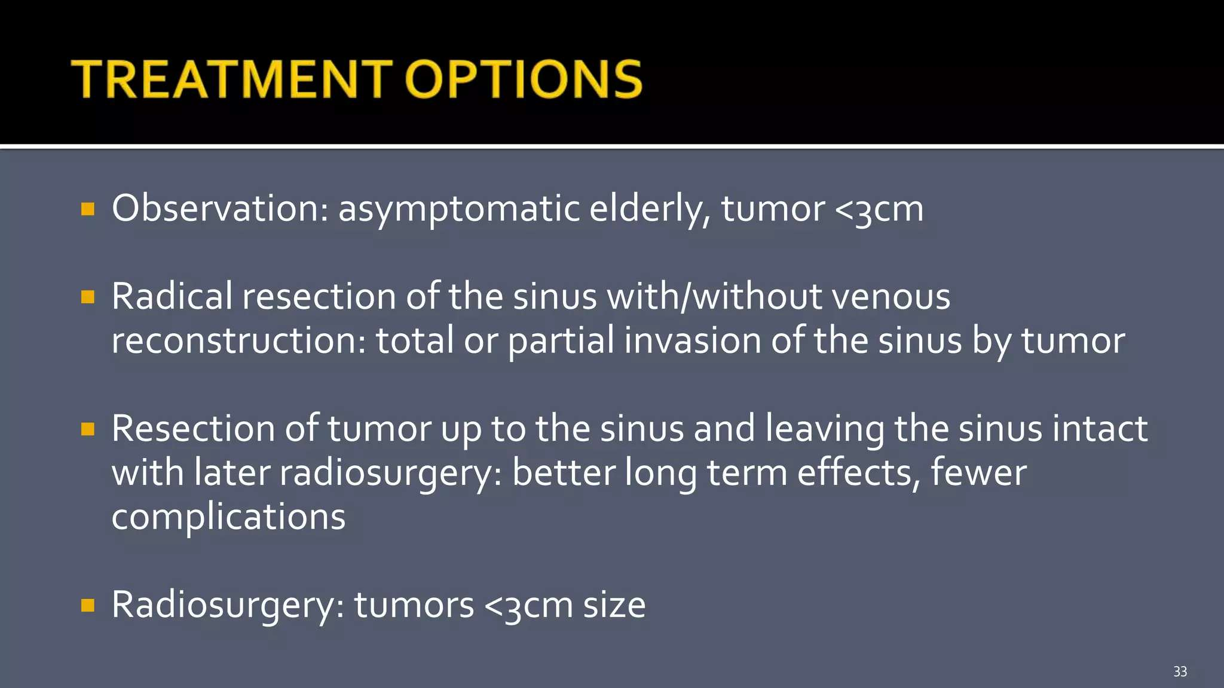

Slide 39
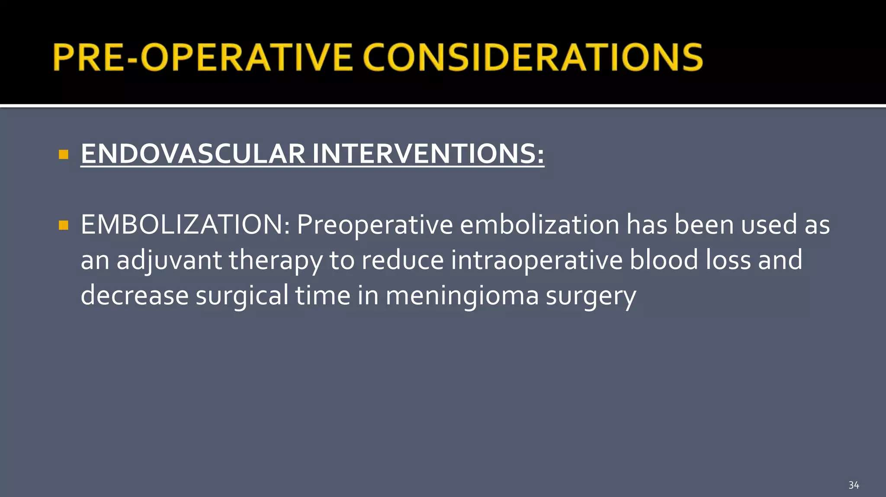

Slide 40
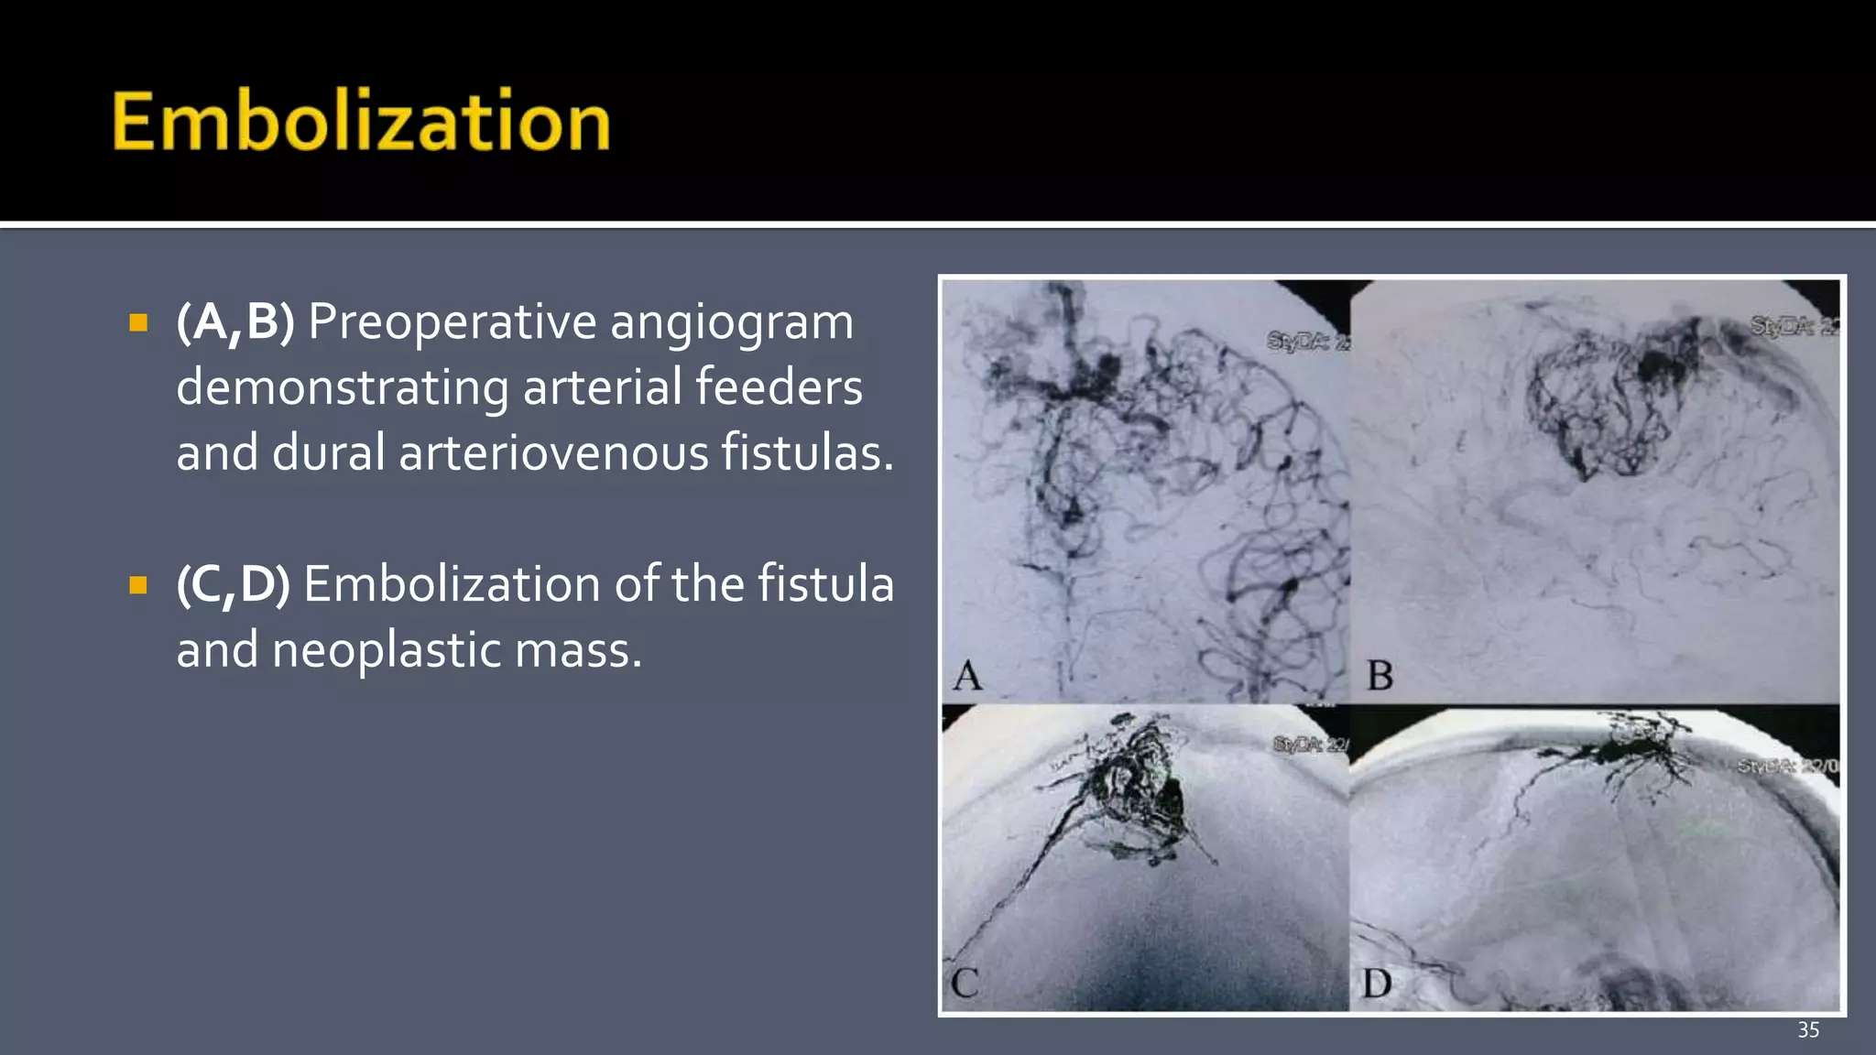

Slide 41
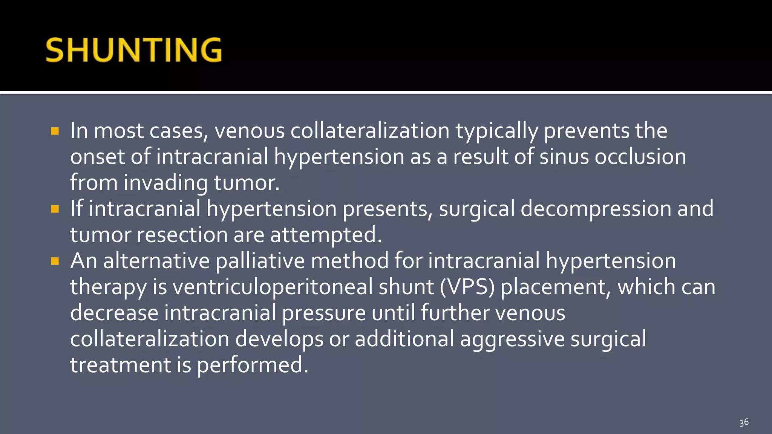

Slide 42
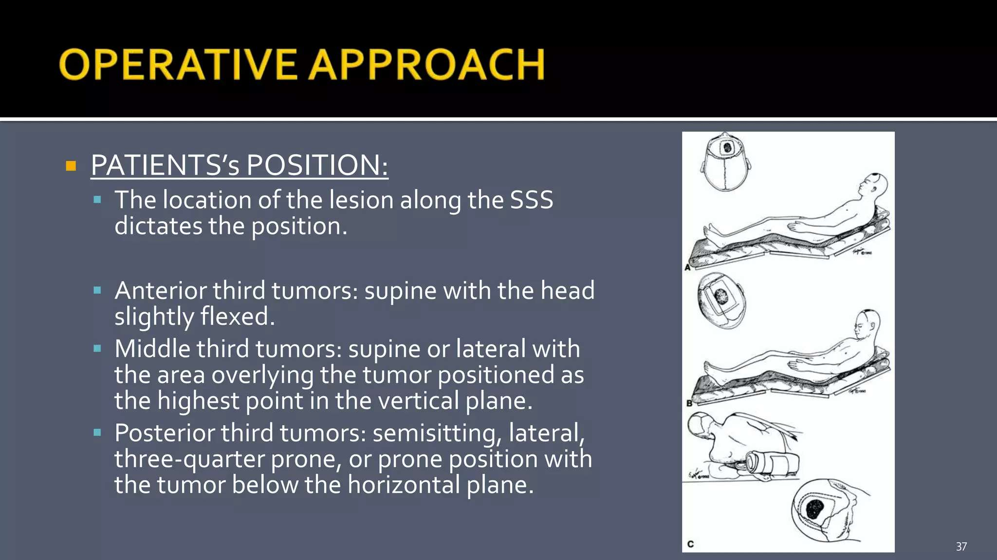

Slide 43
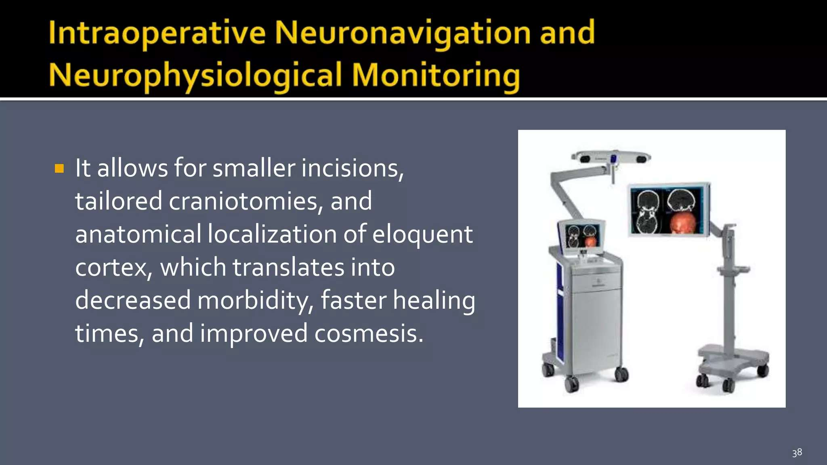

Slide 44
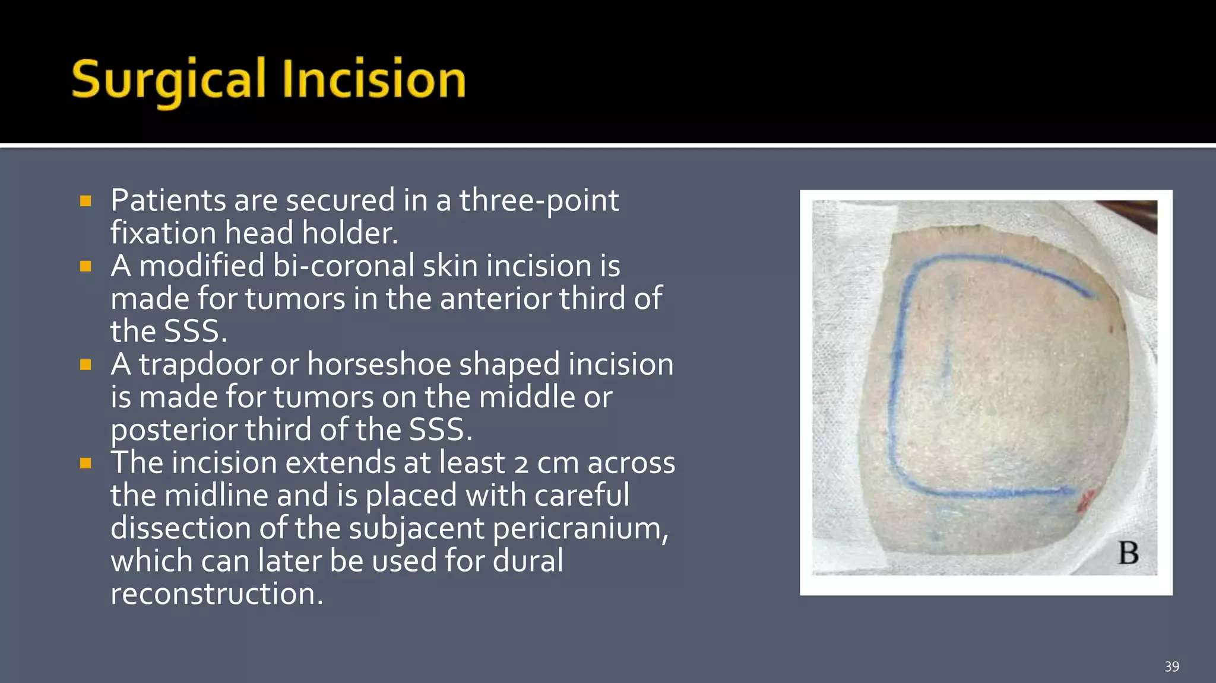

Slide 45
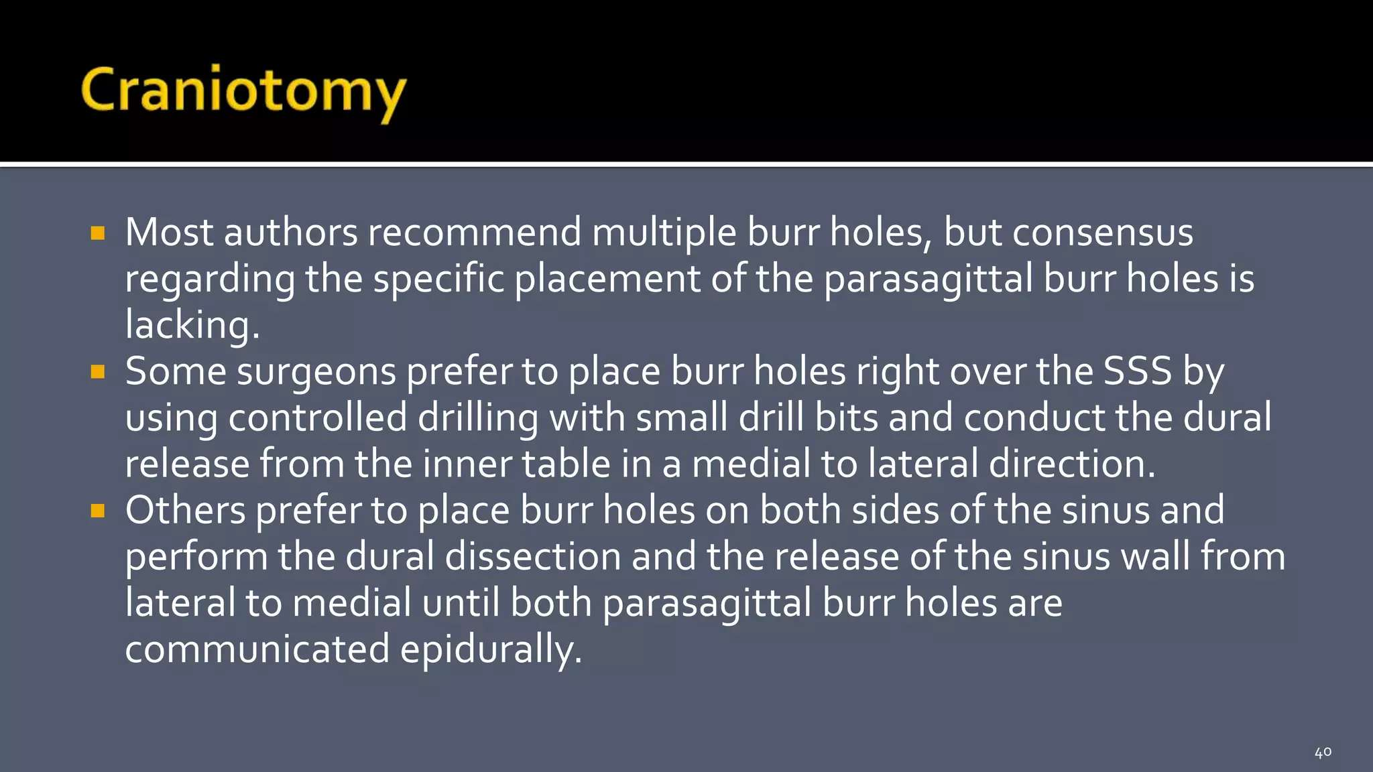

Slide 46
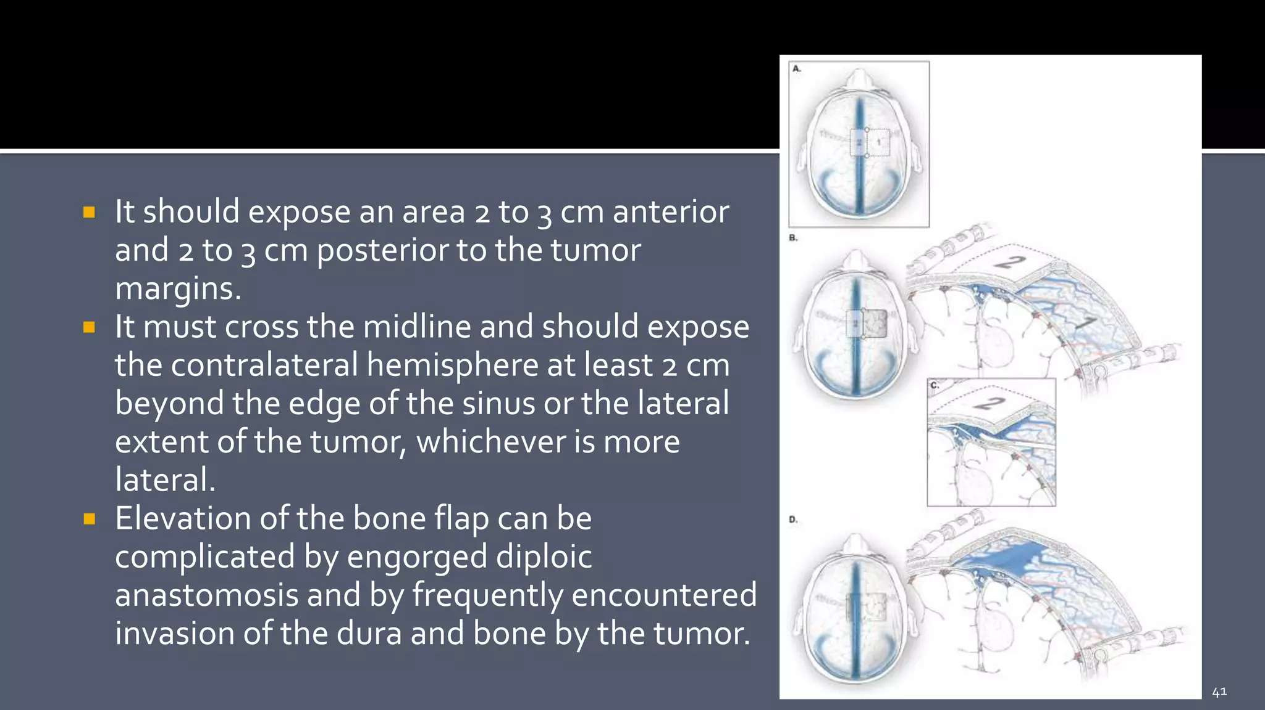

Slide 47
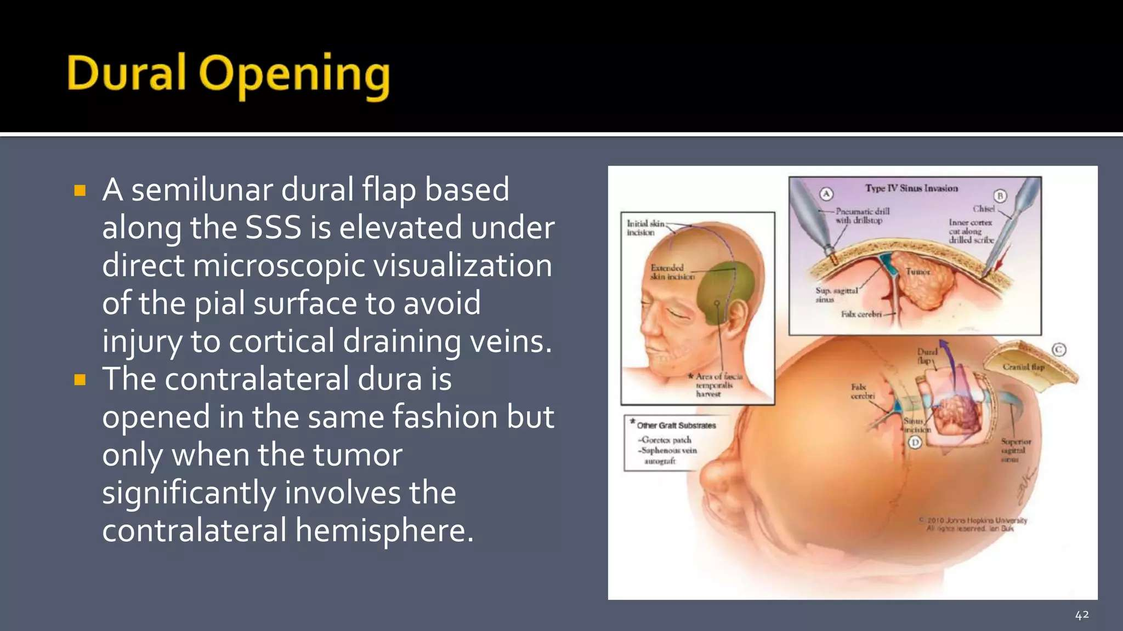

Slide 48
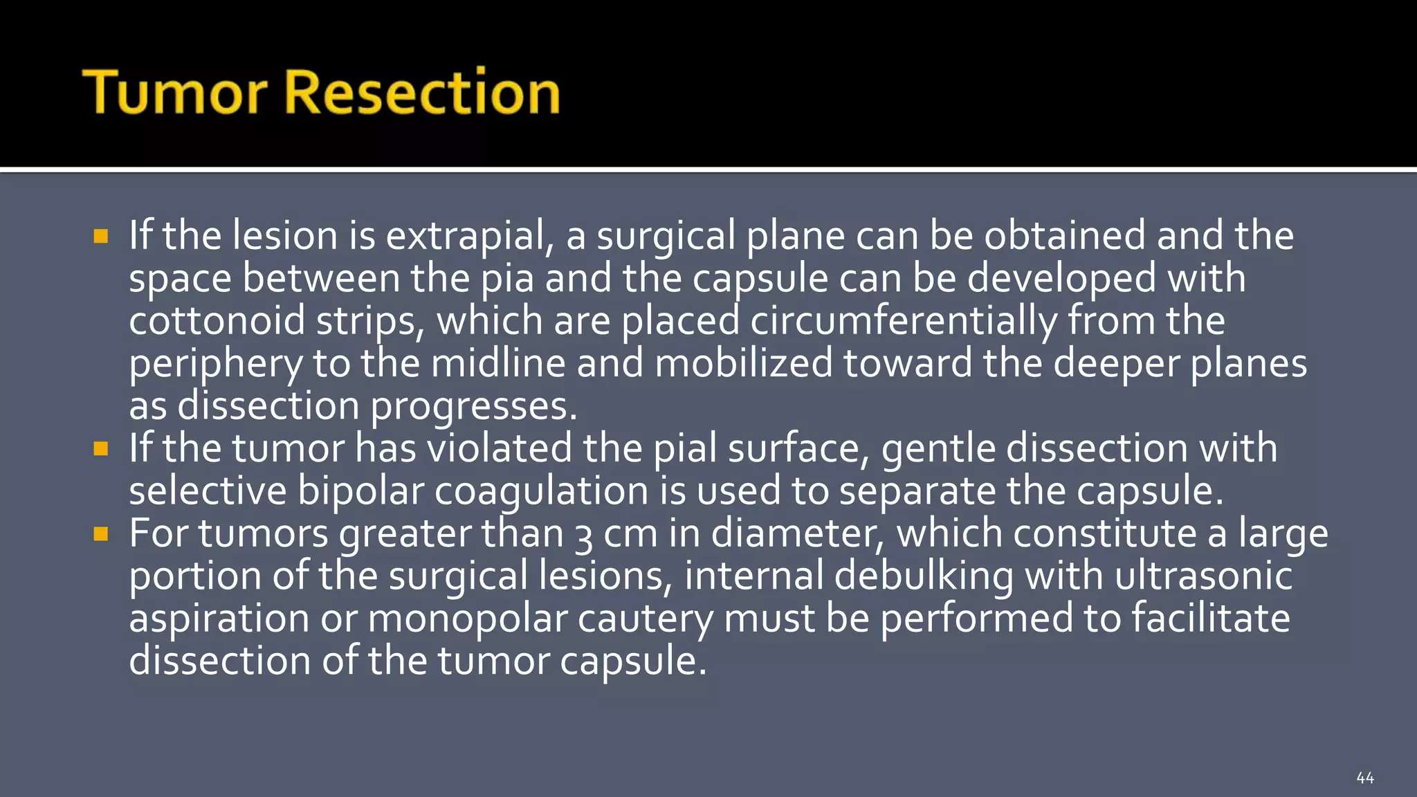

Slide 49
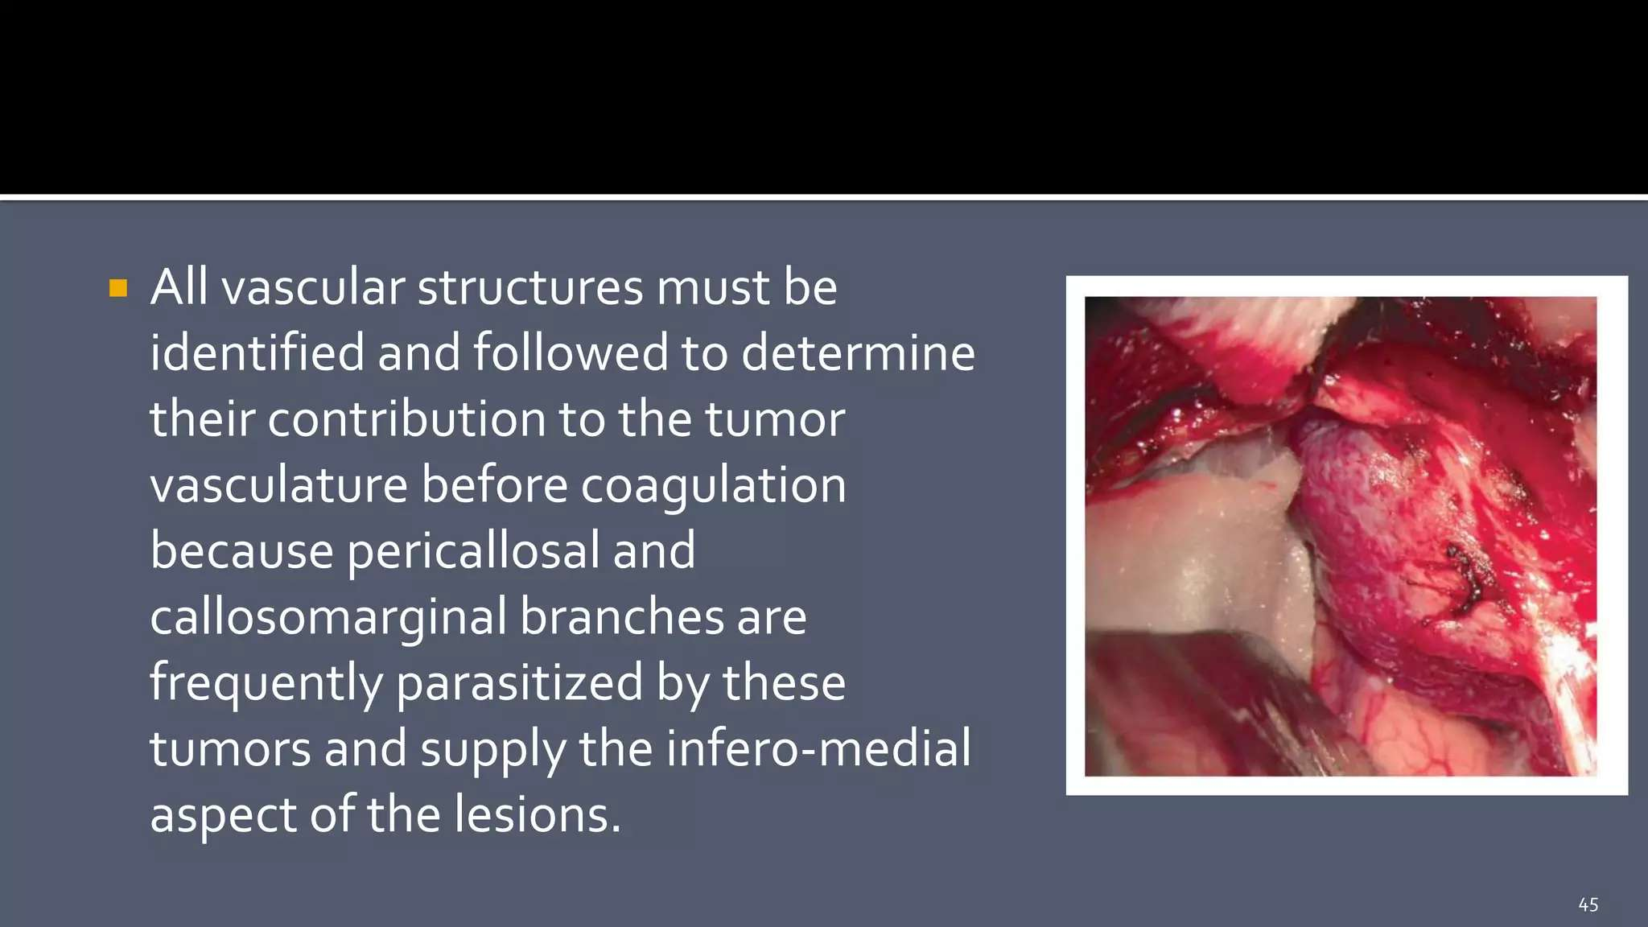

Slide 50
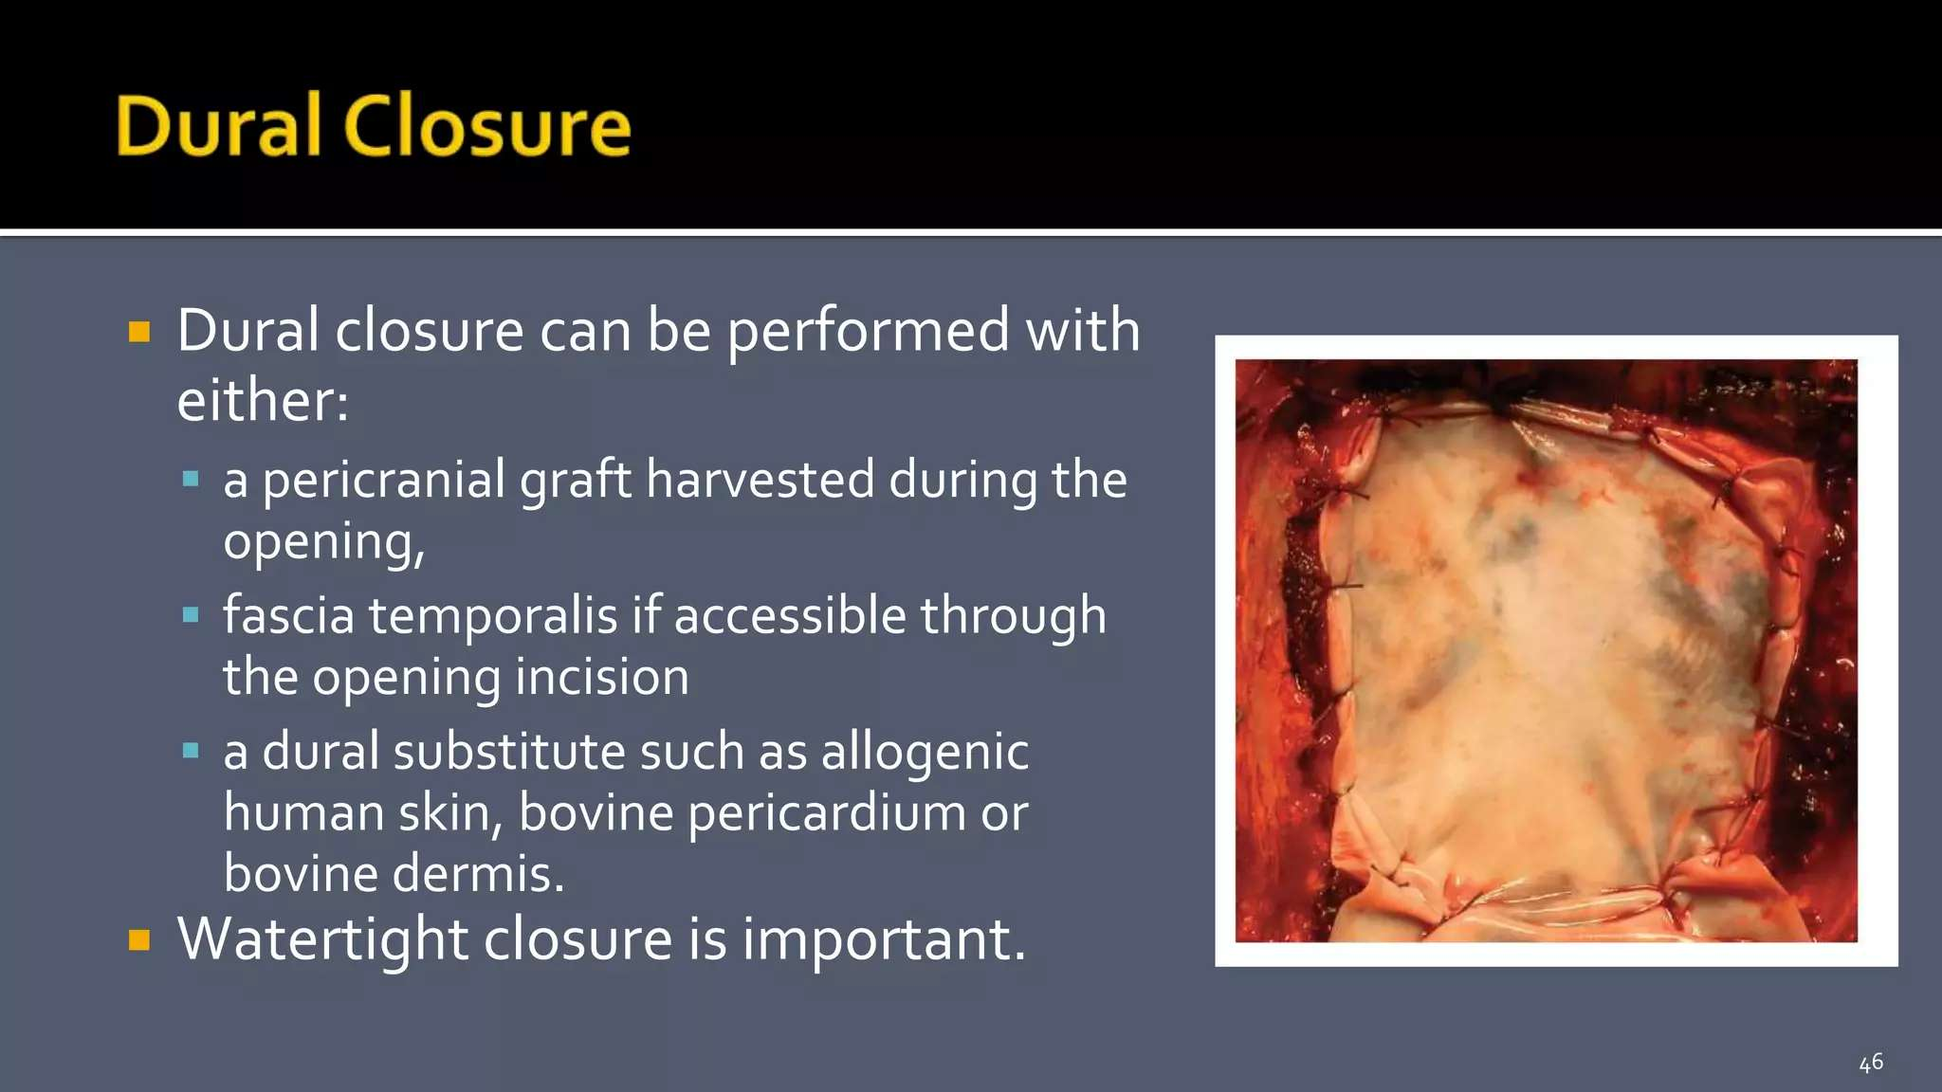

Slide 51
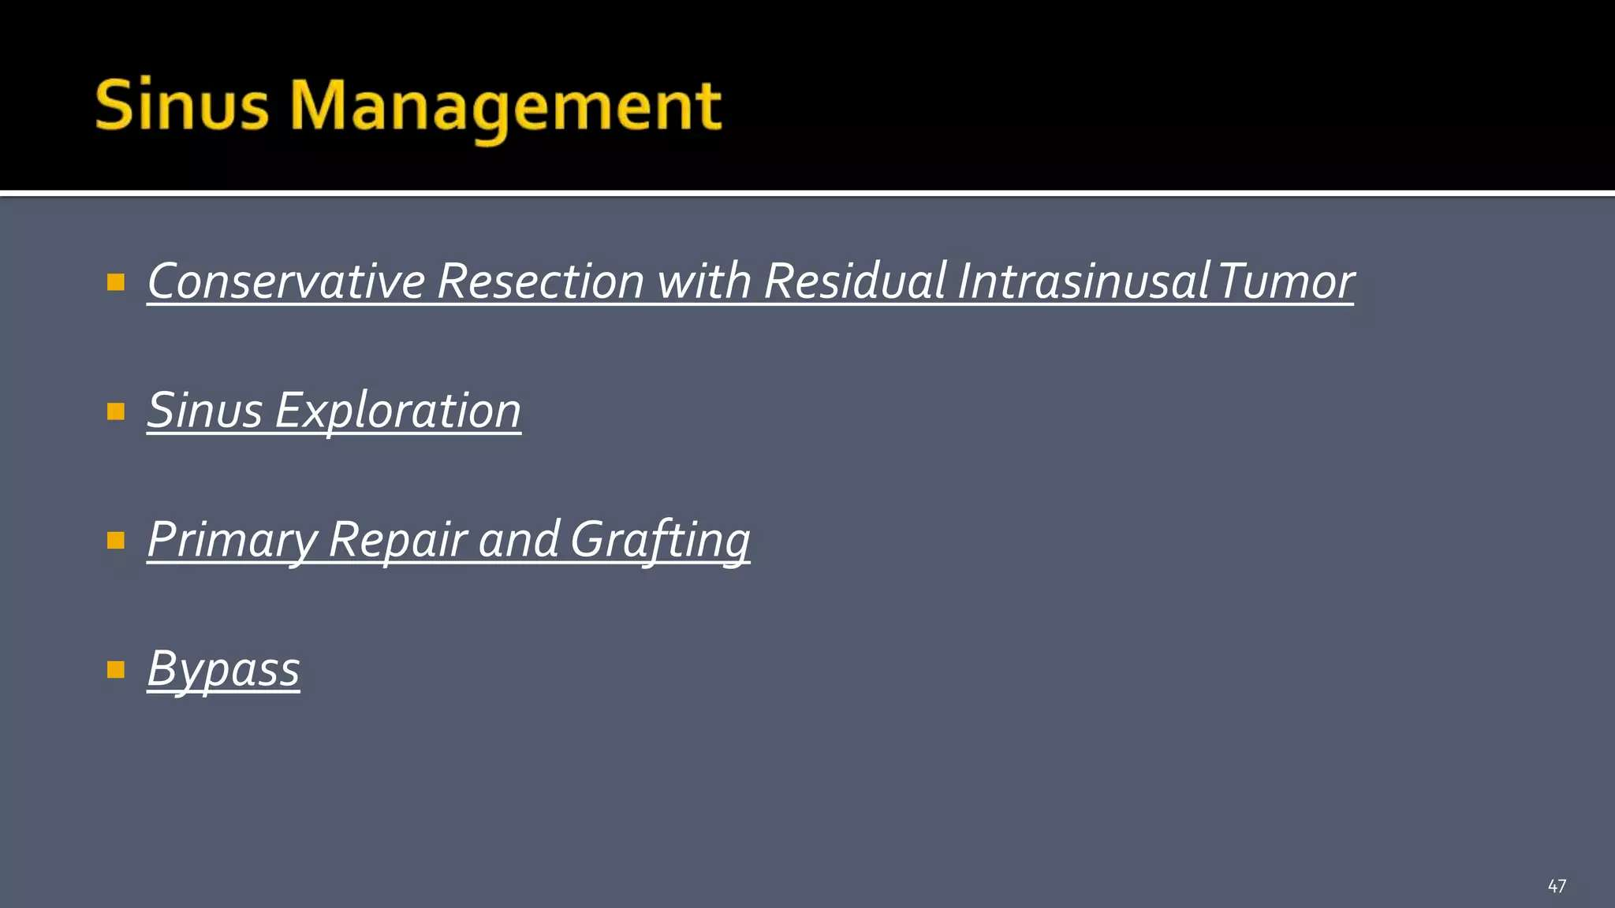

Slide 52
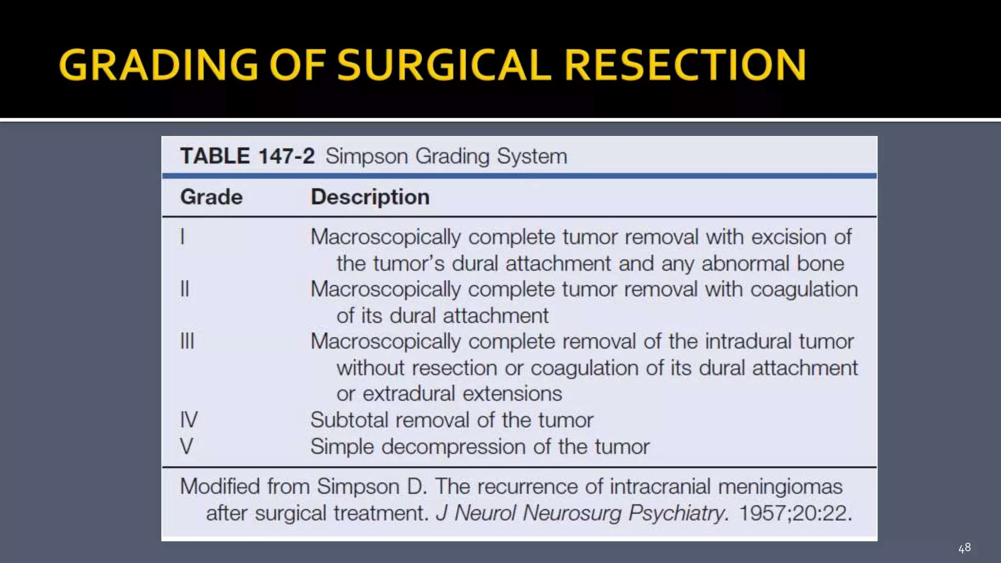

Slide 53
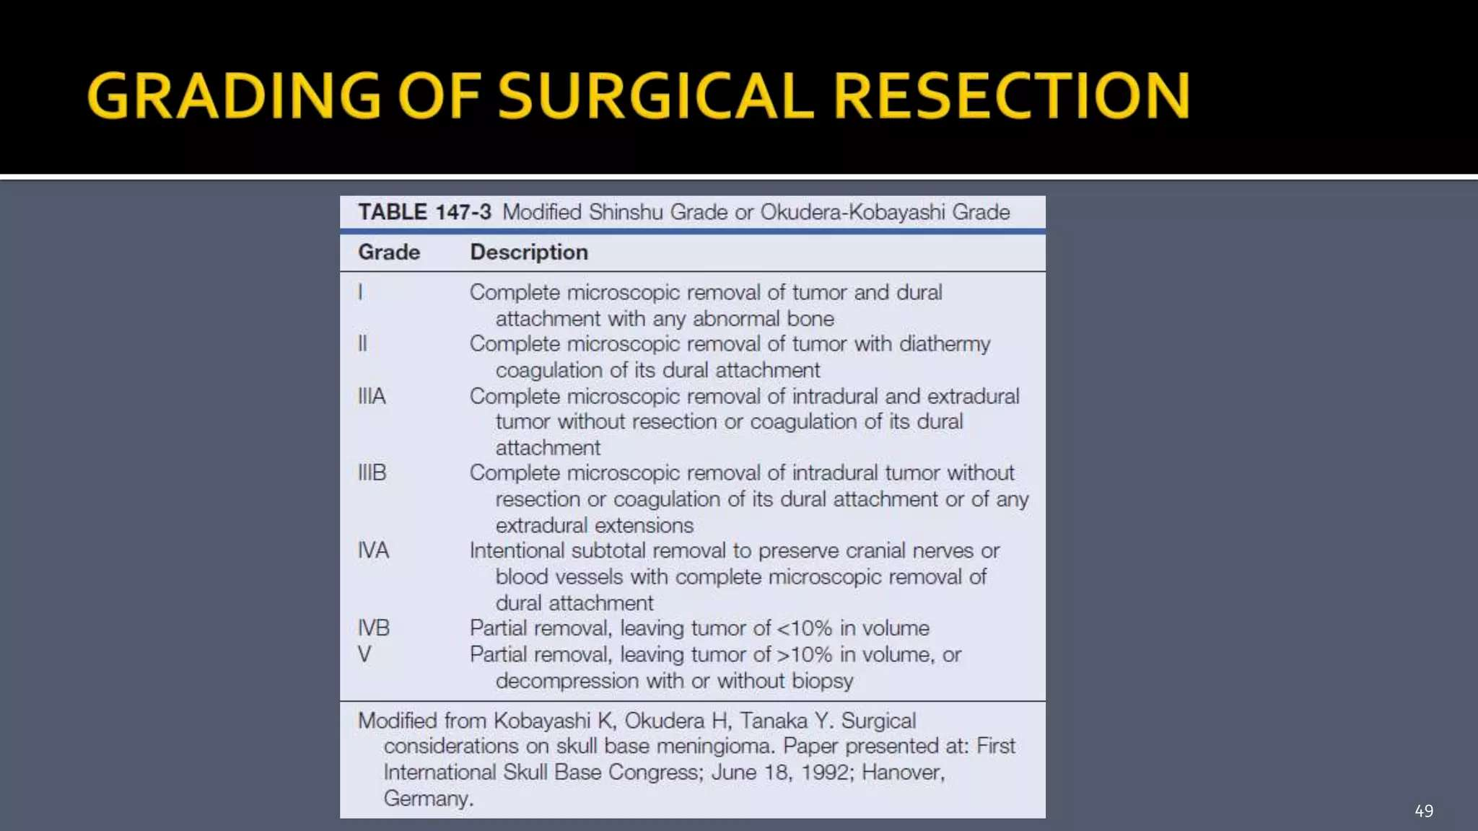

Slide 54
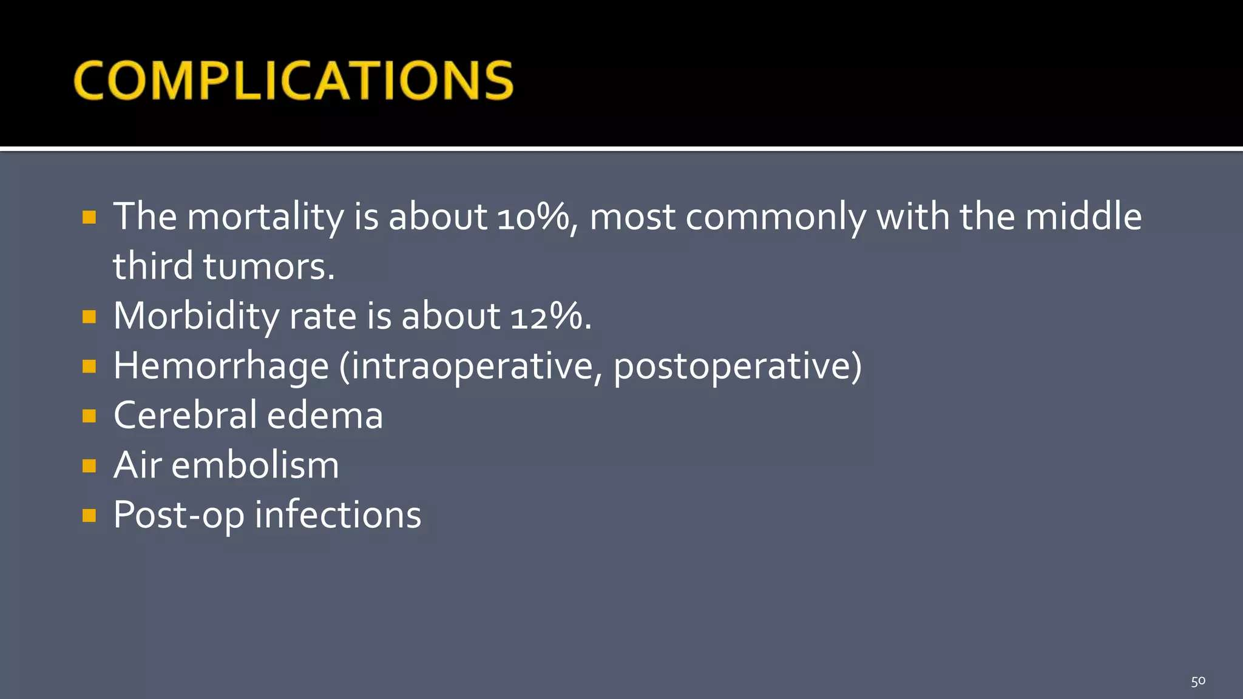

Slide 55


