Slide 1
Spinal Cord Injury
Hemil Maniar, MD
Clinical Assistant Professor
Geisinger Medical Center & Geisinger Commonwealth School of Medicine, PA, USA

Slide 2
Objectives
Overview of Spinal Cord Anatomy
Pathophysiology of Spinal Cord Injury
Classify SCIs based on neurologic involvement
Identify different Spinal Cord Injury syndromes
Medical and Surgical Management
Rehabilitation
Recent Advances

Slide 3
Epidemiology
Annual incidence rate of 15 to 40 persons per million
Occurs predominantly in young, otherwise healthy individuals
Male-to-female ratio for SCI is approximately 4 to 1
Causes - motor vehicle accidents (50%), falls and work-related injuries (30%), violent crime (11%), and sports-related injuries (9%)
56% of all SCI cases occur in the cervical spine.
Lifetime estimated cost of medical care for a 25-year-old patient with SCI is approximately $3 million
Mortality is significantly higher during the first year, is related to level, severity of injury and is influenced by availability of timely, quality medical care.

Slide 4
Anatomy of the Spinal Cord

Slide 5
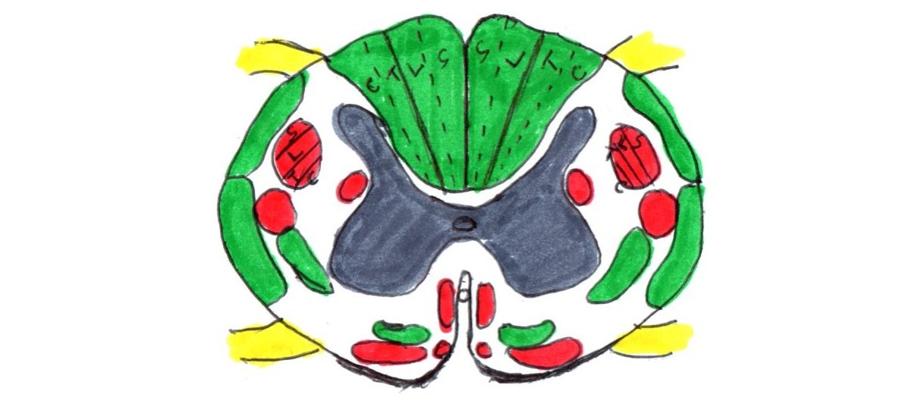
Anatomy of the Spinal Cord
Posterior
Motor and descending pathways (red)
Sensory and ascending pathways (green)
Dorsal Column
Fasciculus Gracilis
Fasciculus Cuneatus
Pyramidal tracts
Lateral Corticospinal tract
Anterior Corticospinal tract
Spinocerebellar tracts
Posterior spinocerebellar tract
Anterior spinocerebellar tract
Extrapyramidal tracts
Rubrospinal tract
Reticulospinal tract
Olivospinal tract
Vestibulospinal tract
Spinothalamic tracts
Lateral spinothalamic tract
Anterior spinothalamic tract
Anterior
*C/T/L/S = Cervical/Thoracic/Lumbar/Sacral

Slide 6
Anatomy of the Spinal Cord
Tract | Function | Side of the body
Anterior Corticospinal Tract | Skilled movement | Opposite
Lateral Corticospinal Tract | Skilled movement | Same
Vestibulospinal Tract | Facilitates extensor muscle tone | Same
Fasciculus Gracilis/Cuneatus | Position and fine touch | Same
Lateral Spinothalamic Tract | Pain and temperature | Opposite
Anterior Spinothalamic Tract | Light touch | Opposite

Slide 7
Pathophysiology of Spinal Cord Injury

Slide 8
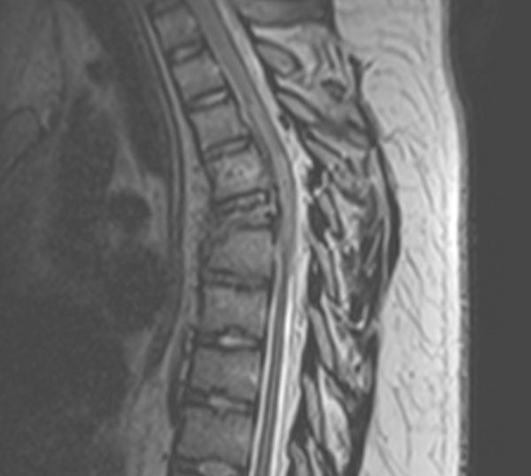
Pathophysiology of Spinal Cord Injury
Biphasic – primary phase and secondary phase
Primary Phase: initial impact as well as subsequent persisting compression
Typically occurs with fracture dislocation, burst fractures, missile injuries, and acutely ruptured discs
Secondary Phase: Primary direct cord injury then triggers a complex and delayed pathologic cascade
Involves vascular dysfunction, edema, ischemia, excitotoxicity, electrolyte shifts, free radical production, inflammation, and delayed apoptotic cell death
Result is cavitation of central gray matter along with partial or complete loss of adjacent white matter tracts.

Slide 9
Mechanisms of Acute Spinal Cord Injury
Primary injury mechanisms
Acute compression
Impact
Missile
Distraction
Laceration
Shear/Stretch

Slide 10
Mechanisms of Acute Spinal Cord Injury
Secondary injury Mechanisms
Systemic Effects
Bradycardia
Hypotension
Hypoxia
Hyperthermia
Local Vascular Changes
Hemorrhage
Loss of microcirculation
Electrolyte Changes
↑sed intracellular Na⁺, Ca⁺⁺ and K⁺
Biochemical changes
Neurotransmitter accumulation
Glutamate excitotoxicity
Arachidonic acid release
Free radical production
Increased prostaglandins & NO
Lipid peroxidation
Endogenous opioids
Cytokines
Decrease ATP production
APOPTOSIS

Slide 11
Pathophysiology of Spinal Cord Injury
Apoptosis
process of programmed cell death
affects restricted populations of spinal cord cells—including oligodendrocytes and some neuronal and astrocytic subpopulations
Oligodendrocyte - plays a pivotal role in injury repair, disease process modulation, and the formation and maintenance of myelin
Oligodendrocyte cell death starts within 24 hours and continues for at least 3 weeks after injury

Slide 12
Classification of Spinal Cord Injury

Slide 13
American Spinal Injury Association (ASIA) Classification
Sensory testing – 28 dermatomes (light touch & pin prick), each side
Motor testing – 10 myotomes, each side
Neurologic level - most distal level with normal function
Motor level - most distal muscle group with a power score of 3 out of 5
Rectal examination is essential, should be accompanied by bulbocavernosus reflex testing to assess for spinal shock
Classification of neurologic deficit as complete or incomplete cannot be determined until spinal shock has resolved
© 2021 American Spinal Injury Association. Reprinted with permission.

Slide 14
Spinal Shock
It is a transient state of complete areflexia after spinal cord injury
Typically resolves 24 hours
During spinal shock there is no residual cord function
End of spinal shock is heralded by return of anal wink or bulbocavernosus reflex
If sacral reflexes do not return – injury is termed complete

Slide 15
Complete or Incomplete SCI?
Rectal Examination
Check for Voluntary Anal Contraction, Deep Anal Sensation or Sensation at Anal Mucocutaneous Junction
Are any of these present?
Yes
No
Incomplete SCI
Complete SCI

Slide 16
ASIA Impairment Scale
A | Complete - No sensory or motor function is preserved in the sacral segments S4-5
B | Incomplete - Sensory but not motor function is preserved below the neurologic level and extends through the sacral segments S4-5
C | Incomplete - Motor function is preserved below the neurologic level, and more than half of key muscles below the neurologic level have a muscle grade of less than 3
D | Incomplete - Motor function is preserved below the neurologic level, and at least half of the key muscles below the neurologic level have a muscle grade of greater than or equal to 3
E | Normal - Sensory and motor function is normal
Initial ASIA classification scale determines prognosis

Slide 17
Algorithm for ASIA Grading
Determine if Spinal shock +/-
Define the neurologic and motor level
Differentiate between complete and incomplete spinal cord injury
Grade as per ASIA Impairment scale

Slide 18
Incomplete Spinal Cord Injuries
Have preserved motor or sensory function below the level of injury OR,
Sacral sparing (preserved rectal motor function or perianal sensation)
Involves ASIA grades B, C, and D
Based on anatomic location within the spinal cord parenchyma, these can also be described by one of several spinal cord injury syndromes (central cord, anterior cord, posterior cord or Brown-Sequard syndromes)

Slide 19
Incomplete Spinal Cord Injury Syndromes

Slide 20
Spinal Cord Injury Syndromes
Central Cord Syndrome
Most common
Extension injury in elderly with spondylotic spine – cord gets “pinched” between anterior osteophytes and posterior infolded ligamentum flavum
Contusion of the central area of the cord (hematomyelia) affects the lateral corticospinal tracts
More centrally located motor fibers from the hand and upper extremity are disproportionately affected

Slide 21
Spinal Cord Injury Syndromes
Most patients present as quadriparetic with or without bladder involvement
Recovery is typically caudal to cranial with return of sacral motor elements followed by lumbar.
Recovery of upper extremity function is minimal and depends on degree of grey matter destruction
Functional recovery is moderate with 75 percent achieving independent ambulatory status

Slide 22
Surgical Management of Central Cord Syndrome
In patients with ongoing cord compression, the effect of surgical timing on functional recovery has not been established conclusively leading to significant controversy about the optimal timing of surgical treatment.
Surgical Treatment for Acute Spinal Cord Injury Study (STASCIS)
Only level I study
Patients who had surgery within 24 hours had greater improvement.
In a meta-analysis which included 1687 patients, La Rosa et al concluded that patients with any traumatic SCI who had surgery within 24 hours had better outcomes than patients who were treated with late decompression or those who were treated conservatively.

Slide 23
Spinal Cord Injury Syndromes
Anterior Cord Syndrome
Direct compression of anterior spinal cord – disc herniation or osteophyte
Direct trauma to anterior cord
Ischemia due to anterior spinal artery involvement from trauma or infection
Loss of motor function and pain and temperature sensation
Preservation of vibration and position sense
Worst prognosis of all incomplete cord injuries

Slide 24
Spinal Cord Injury Syndromes
Posterior Cord Syndrome
Least common
Caused by injury to dorsal column from trauma, tumors or posterior osteophytes/calcified ligamentum flavum
Loss of vibration and joint position sense
Touch, pain and motor function is preserved
Functional recovery is fair.

Slide 25
Spinal Cord Injury Syndromes
Brown-Sequard Syndrome
Hemitransection of the spinal cord
Usually with penetrating injury
Corticospinal tract involvement
flaccid paralysis at the level of the lesion (lower motor neuron),
spastic paralysis below the lesion
Posterior Column (uncrossed fibers) involvement
Ipsilateral loss of proprioception and vibration as well as fine touch
Spinothalamic tract involvement (fibers cross one or two levels after entering the cord)
Contralateral loss of pain, temperature and crude touch
Fairly good prognosis

Slide 26
Medical Management

Slide 27
Management of Spinal Cord Injury
Goals of Management:
Optimize neurologic outcome
Allow for early mobilization by stabilizing the associated spinal injury
Facilitate rehabilitation – consult Rehab medicine early

Slide 28
Medical Management - Cardiovascular
Transection of sympathetic pathways causes bradycardia and neurogenic shock
Important to avoid hypotension – restore intravascular volume with fluids and administer vasopressors if needed
Need an arterial line for blood pressure monitoring
Early restoration of cord perfusion is associated with improved neurologic recovery*
Disruption in autonomic nervous system can cause loss of vasomotor control with impairment in thermoregulation causing severe hyperpyrexia
Treated with external cooling devices like cooling blankets
In an intubated patient it may be mistaken for sepsis if autonomic dysregulation is not considered as a differential diagnosis
Temperatures as high as 109 degrees have been reported
*Lee YS, Kim KT, Kwon BK. Hemodynamic management of acute spinal cord injury: a literature review. Neurospine. 2020 Nov 17.

Slide 29
Medical Management - Pulmonary
More common with cervical as compared to thoracic cord injuries
Associated with loss of intercostal, diaphragmatic and abdominal muscle movements depending to level of injury
Early tracheostomy should be considered in high cervical injuries
Encourage aggressive pulmonary physical therapy and avoid prolonged bed rest

Slide 30
Medical Management – Deep Venous Thrombosis & Pulmonary Embolism
Venous pooling secondary to decreased vascular resistance, combined with a lack of muscle contraction
Mechanical compression decreases the likelihood of blood clotting by increasing venous outflow and reducing venous stasis
Anticoagulation with low-molecular-weight heparin or unfractionated heparin with intermittent pneumatic compression – used for prophylaxis.
Potential contraindications include intracranial bleeding, perispinal hematoma, and hemothorax.
If active bleeding is expected to continue for more than 72 hours, a vena cava filter can be considered

Slide 31
Medical Management – Gastrointestinal & Genitourinary
Nasogastric Suction
Proton Pump Inhibitors or H2 blockers
Consider enteral nutrition once swallowing is evaluated, resuscitation is complete, and there is no evidence of ongoing shock or hypoperfusion.
Placement of an indwelling urinary catheter is recommended no later than in the emergency department.
Increase risk of urinary tract infection is directly associated with duration of catheterization.
Depending on level of injury bladder maybe areflexic or flaccid
Areflexic bladder – abdominal pressure or clean intermittent catheterization may be used
Spastic bladder – if intravesical pressure is not too high and with no sphincter spasticity a condom catheter may be used.
Anticholinergics or smooth muscle relaxers can be used as medical treatment to aid in bladder management

Slide 32
Medical Management – Skin
Immobility and lack of sensation predispose to pressure necrosis
Sacrum, occiput, scapulae, trochanters, ankles, and heels are most affected areas
Appropriate skin care - repositioning every 2 hours, inspecting the skin regularly, and maintaining a clean, dry area underneath the patient

Slide 33
Medical Management – Psychological Issues
Stressful for both patient and family
May become apparent after a few days once things settle down –
Regularly assess for depression, posttraumatic stress disorder, suicidal ideations
Consider use of anti-depression medications

Slide 34
Rehabilitation

Slide 35
Rehabilitation
Goal is to facilitate maximal neurologic recovery through medical and surgical treatment
Rehabilitation is aimed towards developing compensatory strategies for neurologic loss
Involvement of the rehab team early after injury is beneficial
Multimodal approach typically involves physical therapy, occupational therapy, speech and language pathology teams

Slide 36
Recent Advances

Slide 37
Emerging Therapies
Promote neuroprotection
Stimulate intrinsic axonal regrowth
Enhance remyelination
Remove or block inhibitory molecules within damaged myelin and within the astroglial scar.

Slide 38
Emerging Therapies
Methylprednisolone (MPSS)
Most extensively investigated
Antioxidant properties,
Decreases Tumor necrosis factor–α (TNF-α) protein synthesis
Anti-inflammatory
High-dose MPSS has been associated with an increased prevalence of wound infections, pneumonia, sepsis, and death due to respiratory complications
Routine use is controversial, and it should be used with caution

Slide 39
Emerging Therapies
Methylprednisolone (MPSS)
Systematic review suggests
Not offering a 24 hour infusion of high dose MPSS to adult patients who present after 8 hours with acute spinal cord injury
24 hour infusion of high dose MPSS may be offered to adult patients within 8 hours of injury can be offered as a treatment option
Not offering a 48 hour infusion of high dose MPSS to adult patients with acute spinal cord injury
Fehlings MG, Wilson JR, Tetreault LA, et al. A Clinical Practice Guideline for the Management of Patients With Acute Spinal Cord Injury: Recommendations on the Use of Methylprednisolone Sodium Succinate. Global Spine J. 2017;7(3 Suppl):203S-211S. doi:10.1177/2192568217703085

Slide 40
Emerging Therapies
21- Aminosteroids - capable of inhibiting lipid peroxidation
GM-1 Ganglioside - located in high concentrations in the outer membranes of nervous tissue - ability to enhance the function of axons traversing the site of injury but no effect on the gray matter at the level of trauma
Opioid Antagonists – antagonize dynorphins which contribute to neurodegeneration and toxicity
Thyrotropin releasing hormone - antagonize effects of endogenous opiods and excitatory amino acids
Glutamate receptor antagonists – membrane stabilizing effect
Riluzole (Na⁺), Ca⁺⁺ and K⁺ channel blockers – decrease axonal Ca⁺⁺ overload
Erythropoetin - activates neurotrophic, antiapoptotic, antioxidant, and anti-inflammatory pathways
Cyclosporine A - inhibiting mitochondrial permeability transition, lipid peroxidation and free radical formation
Minocycline - can inhibit excitotoxicity, oxidative stress, caspase-dependent and caspase-independent pathways of neuronal death

Slide 41
Emerging Therapies
Cell Transplantation Strategies
Activated Autologous Macrophages
Human Embryonic Stem Cells and Oligodendrocyte Progenitor Cells
Schwann Cells and Peripheral Nerve Grafting
Axonal Regeneration
Phosphodiesterase inhibitors
Removal & Blockade of inhibitory substrates
Chondroitinase ABC – inhibits formation of glial scar

Slide 42
Surgical Management

Slide 43
Role of Early Surgical Decompression
Substantial experimental evidence suggests that persistent compression of the spinal cord is a potentially reversible form of secondary injury
There is no level I studies:
There is no clear definitions of early vs. late surgery
Every spinal cord injury is unique
Its not possible to design a randomized control trial due to ethical consideration
Multiple animal studies have shown a positive effect of early decompression
Multiple evidence-based reviews also show positive effect of early decompression – particulary ones published recently as overall patient care has significantly improved
Lengths of stay, ICU/resource utilization, and economic factors may show potential benefits from early surgery.
Intuitively, it makes sense to operate early but there is paucity of data to support this

Slide 44
Summary
Spinal cord injury is a devastating injury with a significant social impact
Treatment modalities are geared towards decreasing the damage done to the spinal cord during the “second hit”
Early decompression and stabilization is encouraged for better chances at functional recovery
A multimodal team approach – surgeon, anaesthesiologist, intensivists, nursings, physical and occupational therapy, speech therapist all play a vital role in improvement in patient outcomes
Ongoing research on various pharmacologic agents is the key

