Slide 1
In God We Trust
Neurosurgery Morning Report
Department Of Neurosurgery, ABZUMS, Iran
Professor: Dr.Torabi
Presented : Dr.Malekzadeh
http://94.182.36.126:8083/study/hisLink/2310773
2145503

Slide 2
Chief Complaint
13 Years Old Boy
1.Severe, incapacitating Radicular right lower extremity pain.
2.Progressive urinary incontinence.

Slide 3
History of Present Illness
This is a 13-year-old male with a history of normal development until age 10, when he developed urinary incontinence + Urgency and was evaluated for a neurogenic bladder.
He presented recently with an acute deterioration characterized by severe, debilitating radicular pain in his right leg, rendering him unable to walk. He was admitted to a hospital where initial labs revealed critical renal failure with a creatinine of 7.0 mg/dL.
During his admission, an MRI was performed. Despite an initial (and likely erroneous) interpretation of cervical stenosis, the patient’s classic combination of progressive urological failure, lower back pain, and acute radiculopathy led to the primary suspected diagnosis of Tethered Cord Syndrome.

Slide 4
Review of Systems
• General: No fever, chills, weight loss
• Neuro: Radicular Right Leg Pain
• GU: Urinary urgency + Incontinence
• Others: GI, Cardiac, Respiratory, MSK unremarkable

Slide 5
Past History
• Medical: Hypertension, ESRD
• Medications:
Amlodipine 2.5mg BD | Baclofen 5mg BD | Ferrous Sulfate 50mg BD
Folic Acid 1mg Daily | Vit D 50000 Po Monthly |Nephrotonic Po Daily
Terazosin 2mg Po Daily |SevelAmer 800 PO TDS
• Allergies: NKDA

Slide 6
Family & Social History
• No relevant family history
• Independent until symptom progression
• Nonsmoker, no alcohol, no drug use

Slide 7
Vitals on Admission
• Temp: 36.8 °C
• HR: 82 bpm
• BP: 128/78 mmHg
• RR: 16/min
• SpO₂: 99% on room air

Slide 8
General Appearance:
Teenage male, appears uncomfortable and in pain. Lying still in bed.
A prominent, Soft, non-tender and non-mobile subcutaneous mass (~5x4 cm) is visible and palpable in the lumbosacral midline. This finding is highly suggestive of a subcutaneous lipoma associated with spinal dysraphism (e.g., a lipomyelomeningocele).
No overlying skin discoloration, hemangioma, or open defect is noted
Tenderness: Tenderness to deeper palpation over the L5-S1 spinous processes was not present.

Slide 9
Neurological Exam – Motor
•Cranial Nerves: Intact
• Upper Extremities: 5/5 bilaterally
• Lower Extremities: 5/5 bilaterally

Slide 10
Neurological Exam – Reflexes, Sensory, Gait
• Tone: Normal
• Reflexes: 2+ in knees/ankles, Babinski positive
• Sensation: Nl
• Coordination: Nl
• Gait: Nl
Urinary urgency + Incontinence

Slide 11
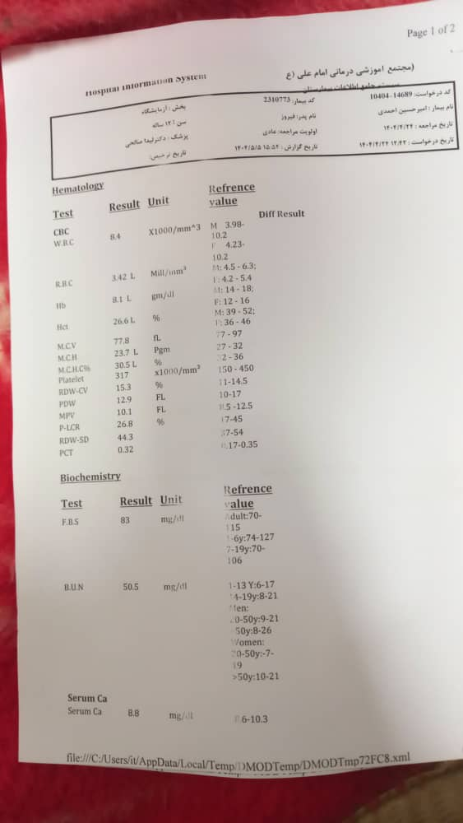

Slide 12
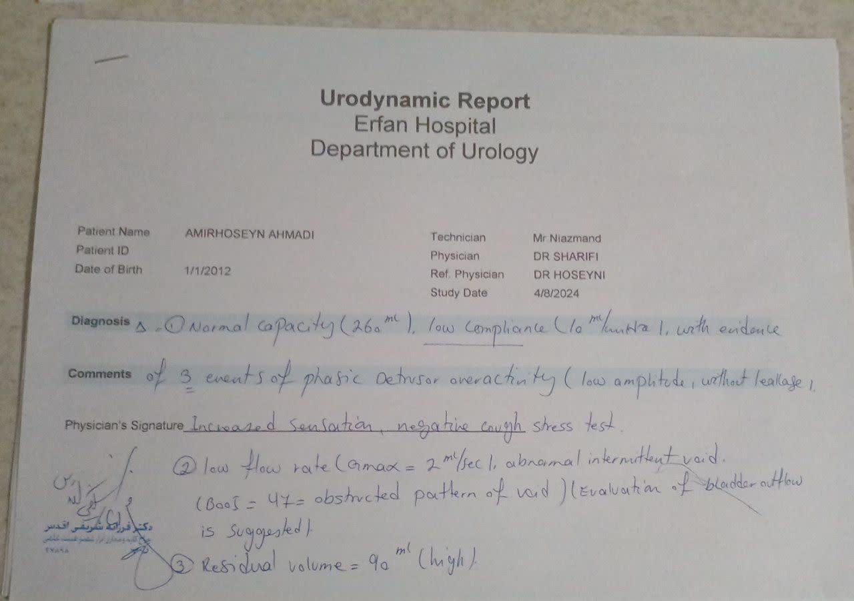

Slide 13
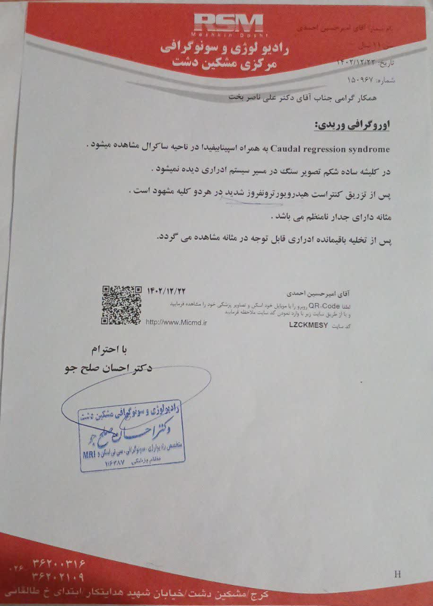

Slide 14
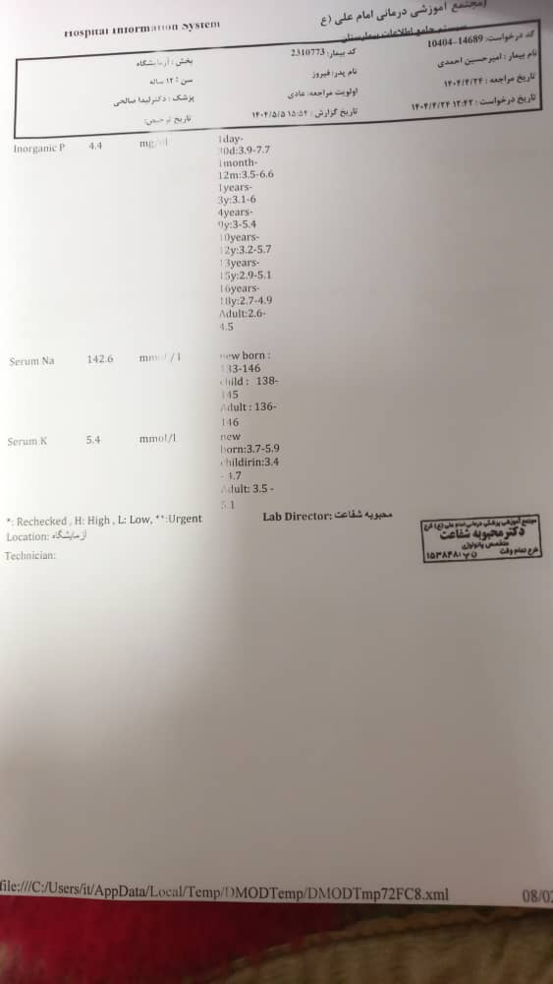

Slide 15
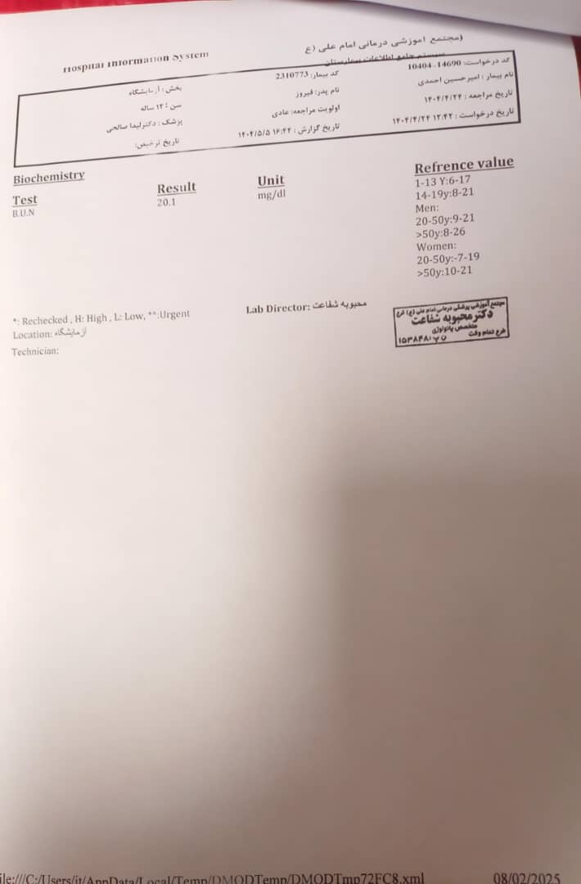

Slide 16
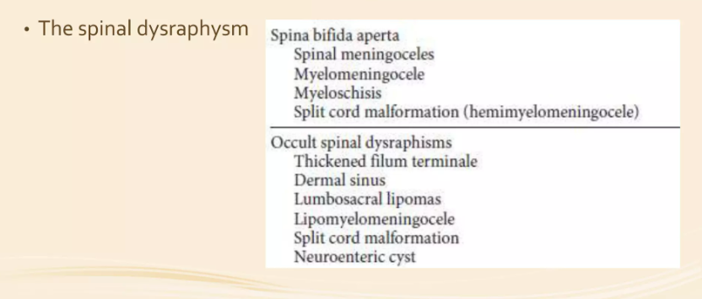

Slide 17
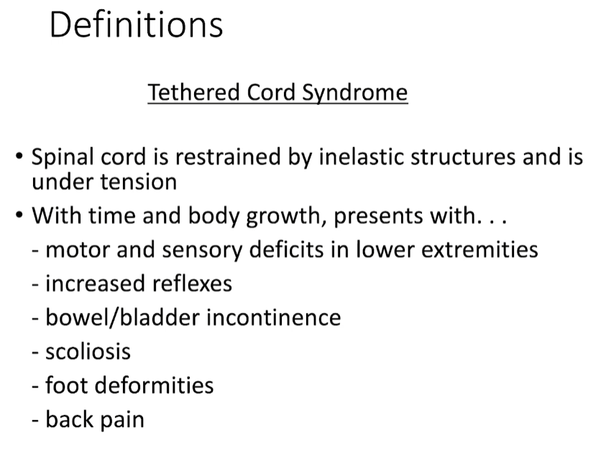

Slide 18
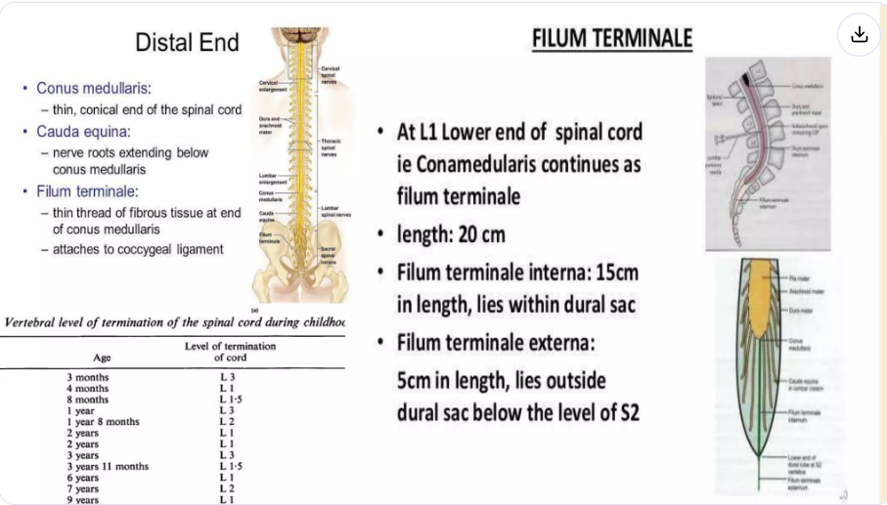

Slide 19
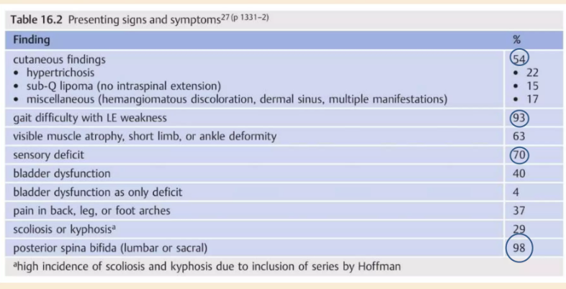

Slide 20
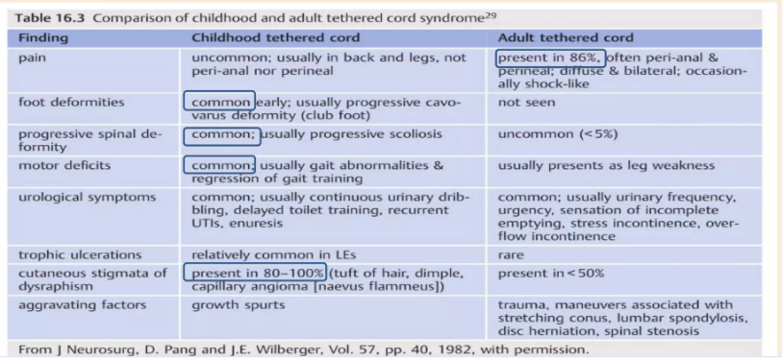

Slide 21
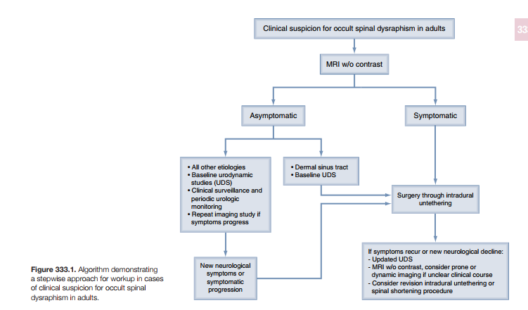

Slide 22
Thank you for your attention.

